Slide 1
An event-based model of language evolution
John P. Huelsenbeck
Shawn McCreight
Éva Buchi
David Goldstein

Slide 2
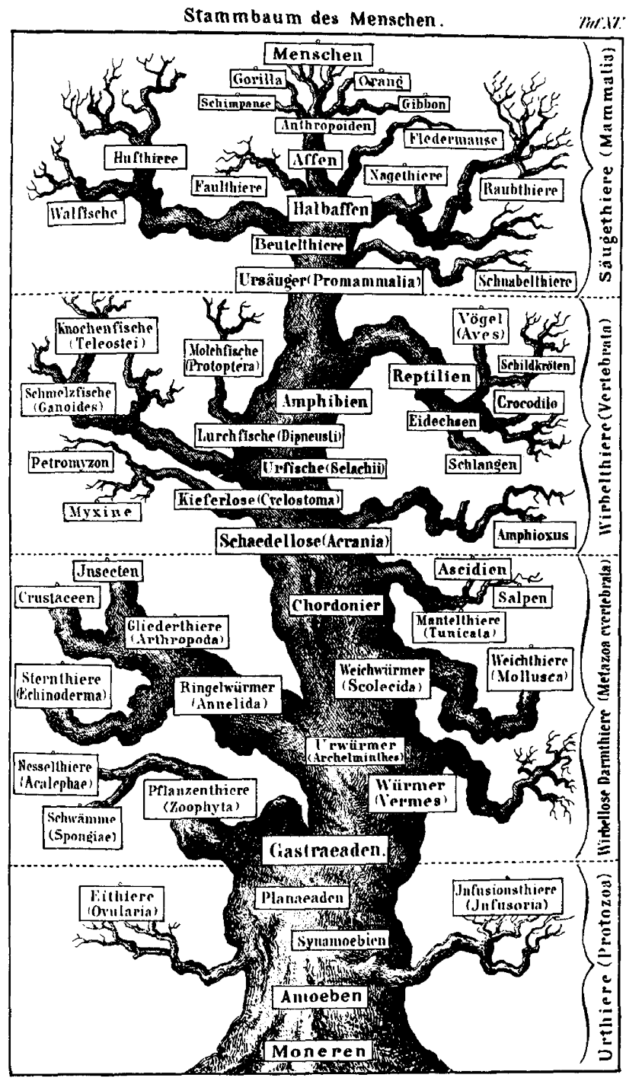
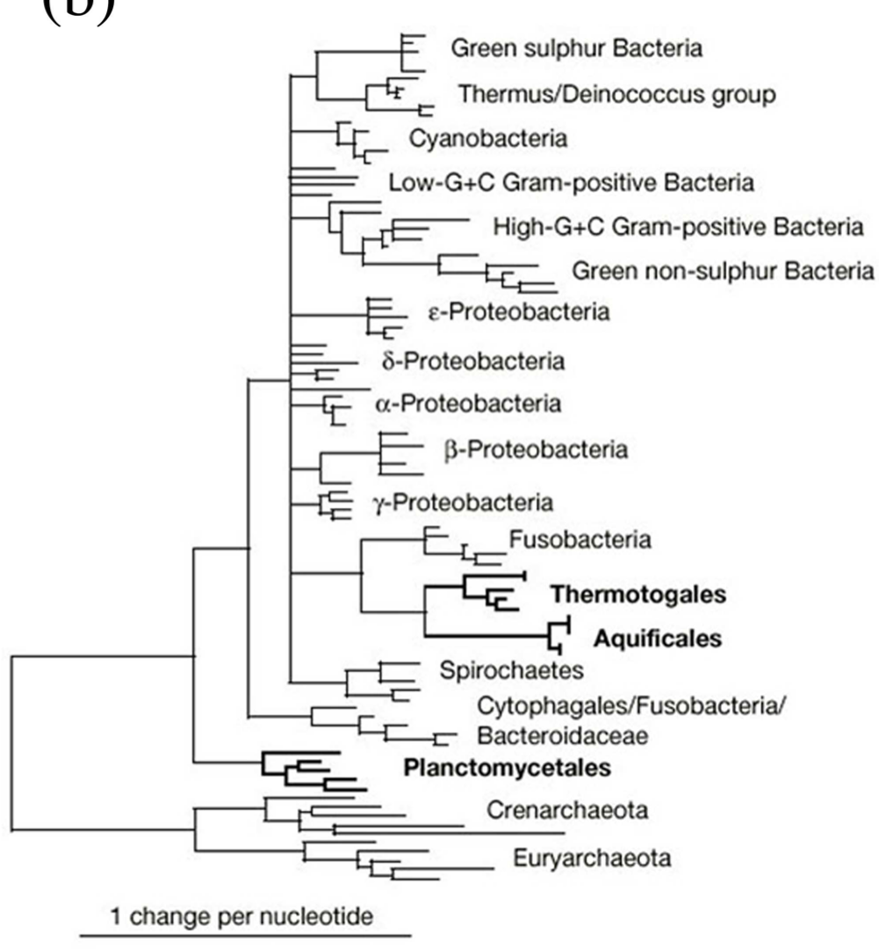
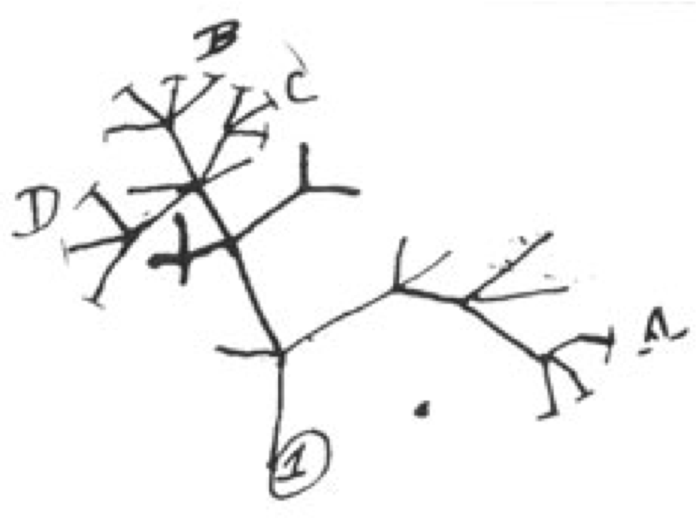

Slide 3
August Schleicher (1863) Die Darwinshce Theorie und die Sprachwissenschaft (The Darwinian Theory and the Science of Language).

Slide 4
L. Luca Cavalli-Sforza (1997) Genes, peoples, and languages. PNAS.

Slide 5
Obvious problems with any phylogenetic analysis of language
Sharing of words across languages
Horizontal transfer of words, from one language to another
Word borrowing

Slide 6
Obvious problems with any phylogenetic analysis of language
Sharing of words across languages
Horizontal transfer of words, from one language to another
Word borrowing

Slide 7
Obvious problems with any phylogenetic analysis of language
Sharing of words across languages
Horizontal transfer of words, from one language to another
Word borrowing

Slide 8
Cognates: Words having the same linguistic derivation, derived by direct descent from an etymological ancestor in a common parental language.
Sanskrit: | mātár | pitár | tráya
Greek: | mḗtēr | patḗr | treîs
Latin: | māter | pater | trēs
French: | mère | père | trois
Spanish: | madre | padre | tres
German: | Mutter | Vater | drei
English: | mother | father | three
Old Irish: | māthir | athir | trī
Swadesh List: Morris Swadesh (1909–1967) compiled a list of about 200 words related to “universal concepts” that are thought to be resistant to borrowing. (If you are an evolutionary biologist, think of these words as good phylogenetic markers.)

Slide 9
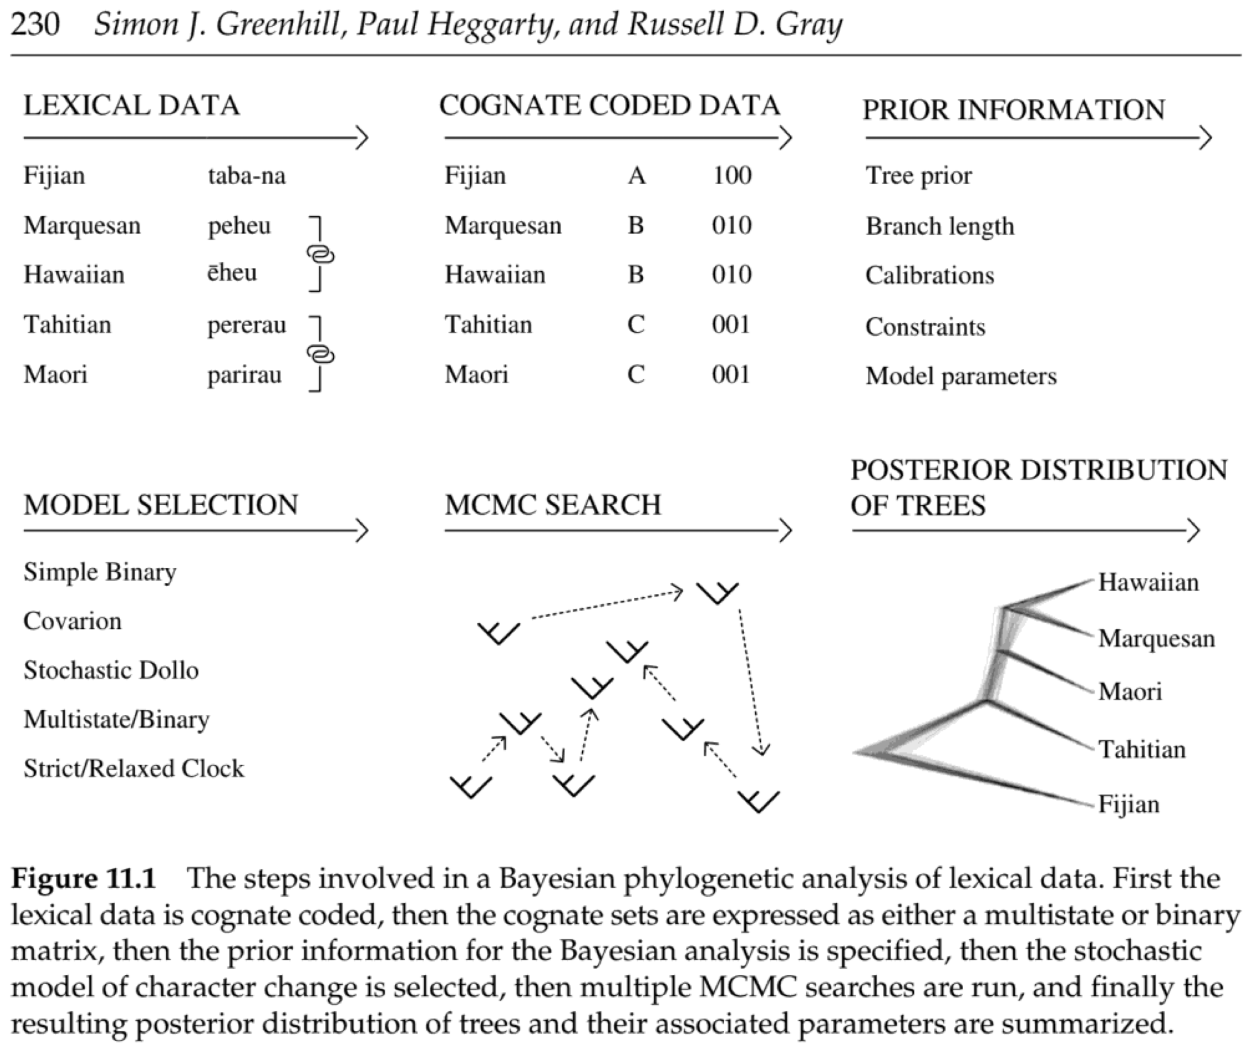
Greenhill, S. J., P. Heggarty, and R. D. Gray. 2020. Bayesian Phylolinguistics. Pages 226–253 inThe Handbook of Historical Linguistics, First Edition. Edited by Richard D. Janda, Brian D. Joseph, and Barbara S. Vance. John Wiley & Sons, Inc.

Slide 10
Linguistics characters treated as morphological data in evolutionary biology
Note that they often take one cognate and code it as several (non-independent) characters.
Should condition on some data patterns never making their way into the character matrix.
Because the 0s and 1s in the coding scheme are arbitrary, one should be able to flip the states and obtain the same likelihood.
Limitations on the types of models that can be applied, such that rates of change should be symmetrical.
Gray is enamored by the covarion model. I wonder if the good fit of that model is an artifact of the coding procedure?
It’s not clear what the elemental changes are in the language. In other words, while you can learn about phylogeny, you cannot learn about how words transform over time.

Slide 11
Our Approach
Treat the observations as the word segments (syllables) of the words as they are pronounced by speakers of the language.
In an instant of time, words can change through three basic transitions: (1) a substitution of one word segment for another, (2) an insertion of a single word segment in the word, and (3) a deletion of a single word segment in a word.
This is equivalent to the TKF91 model of molecular evolution.
We estimate the parameters in a Bayesian framework (of course!)
We use MCMC to sample all of the model parameters, including the alignment of the word segments.

Slide 12
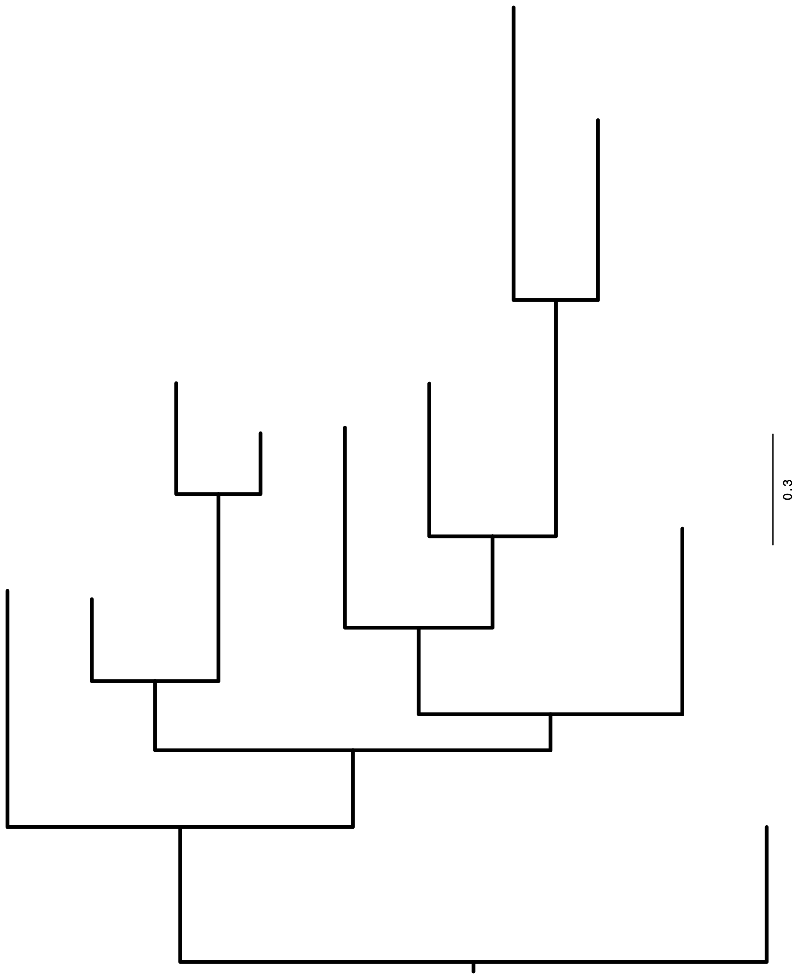

Slide 13
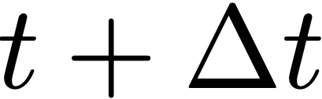

Nothing happens
1
2
3
4
5

Slide 14
Substitution
1
2
3
4
5

Slide 15
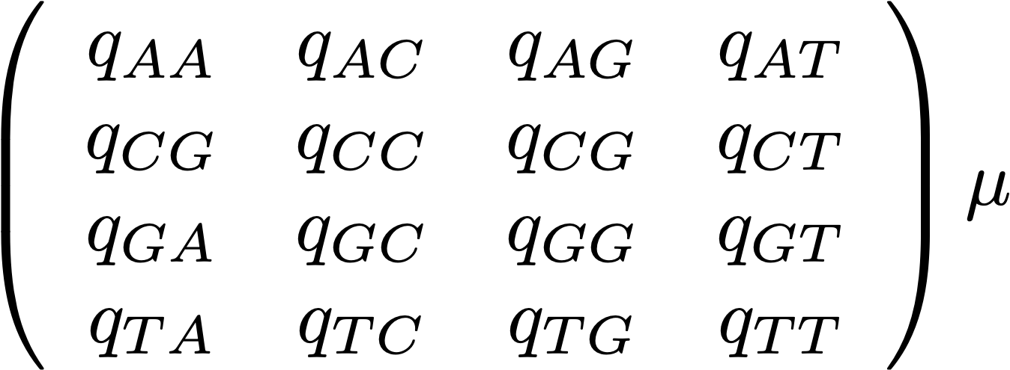
To
A
C
G
T
A
C
From
G
T

Slide 16
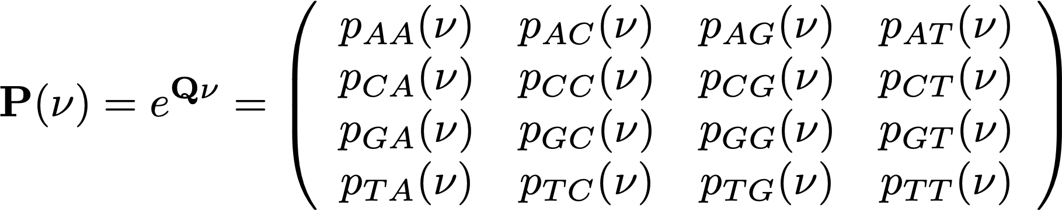
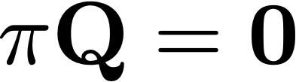
Transition Probabilities
Stationary Probabilities

Slide 17
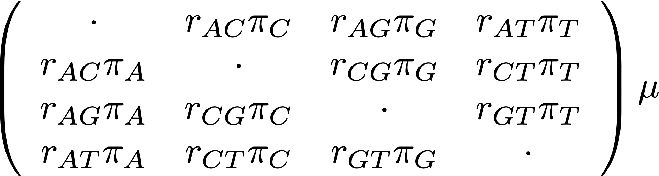
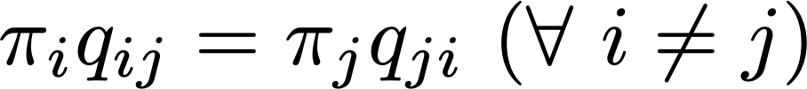
General Time Reversible (GTR) Model
Tavaré (1986)

Slide 18
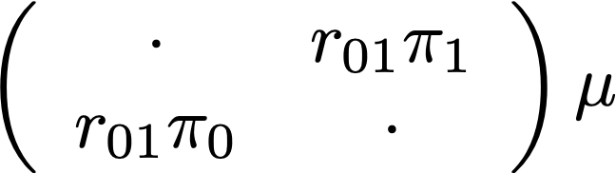
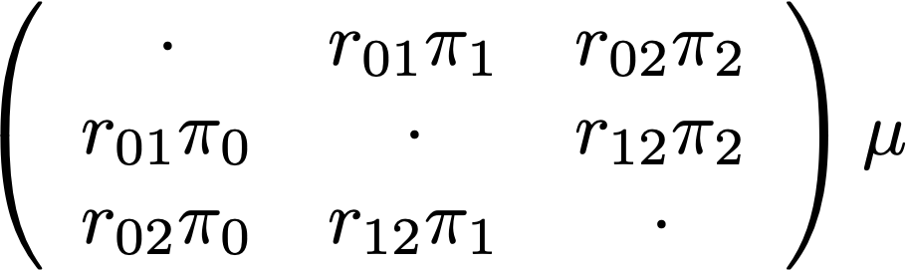
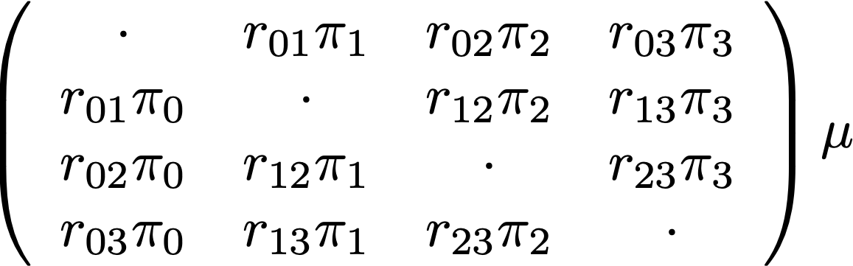
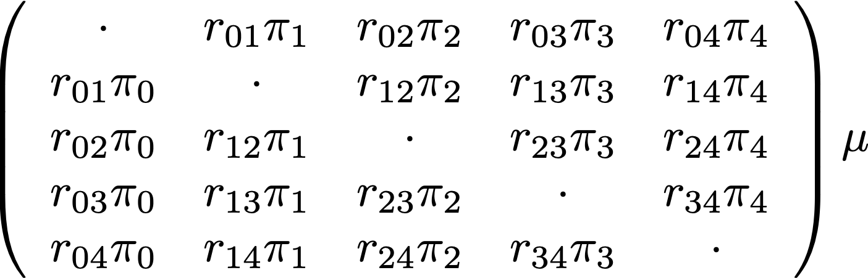
2 States
3 States
4 States
5 States

Slide 19
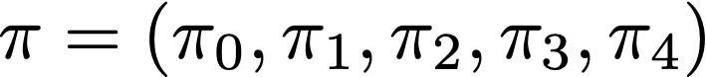
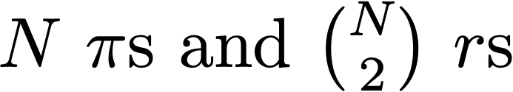

Slide 20
Deletion
1
2
3
4
5

Slide 21
Insertion
3’
1
2
3
4
5

Slide 22
TKF91 Model
Insertions occur at a rate $λ$
Deletions occur at a rate $μ$
If $λ>μ$ the sequence length would expand without bounds!
Thorne et al. constrain $λ<μ$, which means that the sequence should shrink to zero length
They introduce the idea of an “immortal” link in the sequence such that the sequence can always be added to, even to a “sequence” of length zero.
The sequence length then is a Geometrically-distributed random variable with parameter $λ/μ$
* A • C • T • T • G • T • A • C • C • C • A • C • C • G • A • A • T •

Slide 23
Goldstein/Buchi
Linguists from UCLA and Université de Lorraine, respectively, and experts on Romance languages. They have been collecting the data.
McCreight
Data curation and analysis through Nytril
Huelsenbeck
Wrote C++ code implementing TKF91 model and statistical/phylogenetic knowledge

Slide 24
What is Nytril?
Program written by Shawn McCreight
Java, C#, Javascript-like object oriented syntax
All-in-one integrated development environment with integrated debugger and git functions
Low and high level math with basic algebra, numbers, vectors, and matrices
LaTeX style typesetting power with programmable popups
Easy file input and output and database support
One-click publication to your computer and web
Could go a long way toward solving the persistent problem of file management and replication in genomic studies

Slide 25
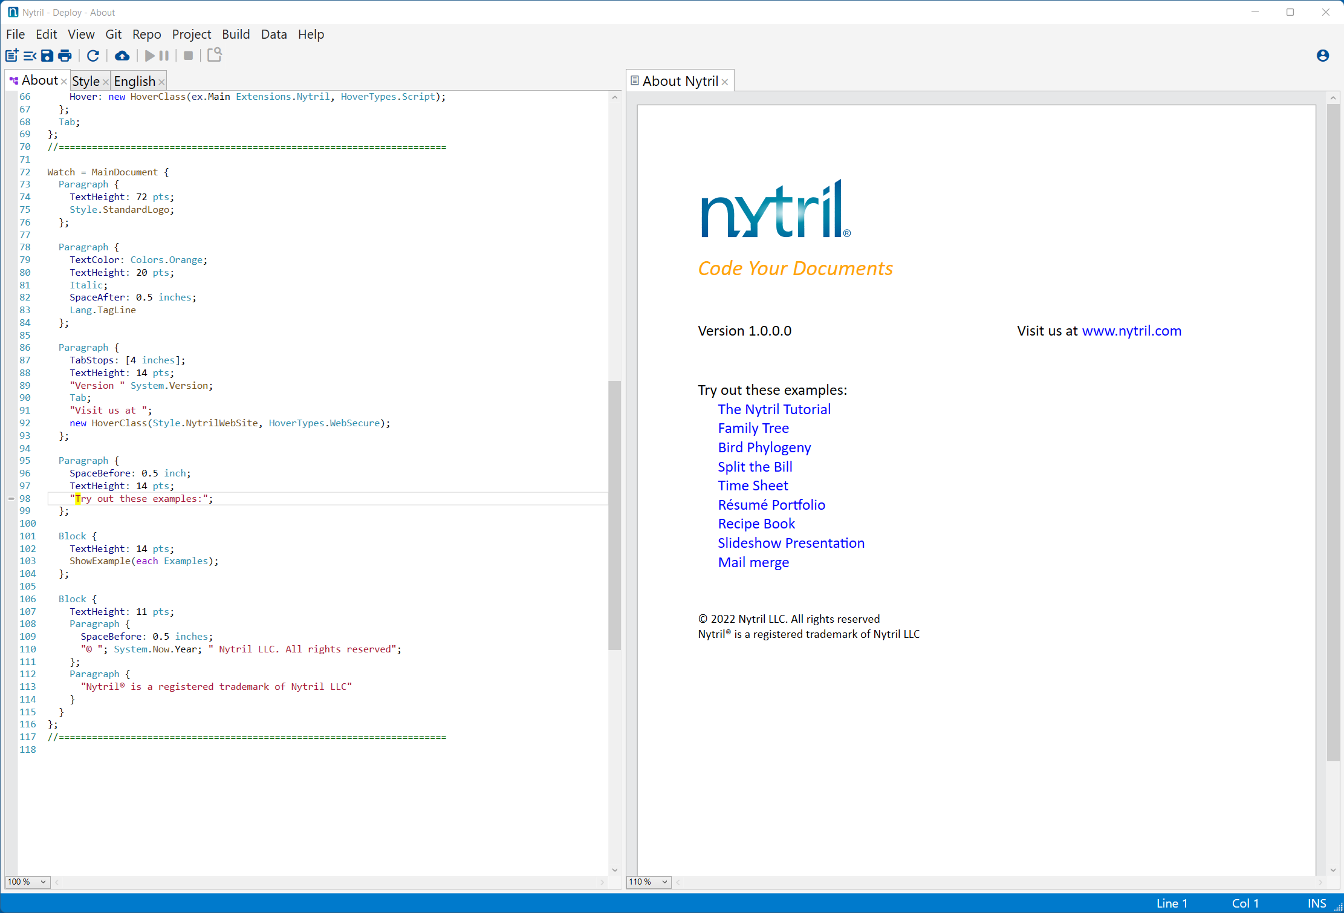

Slide 26
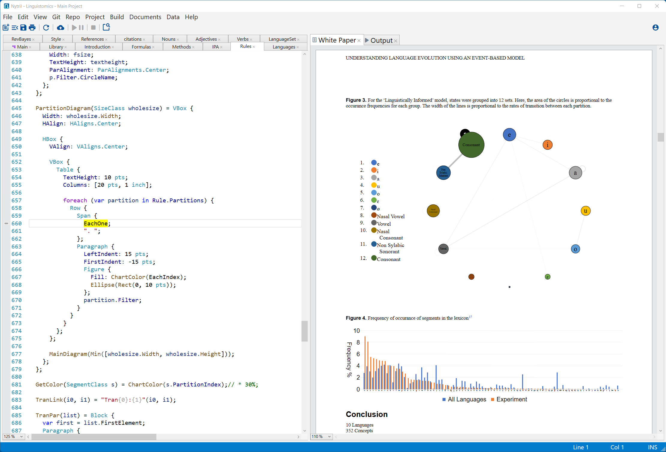

Slide 27
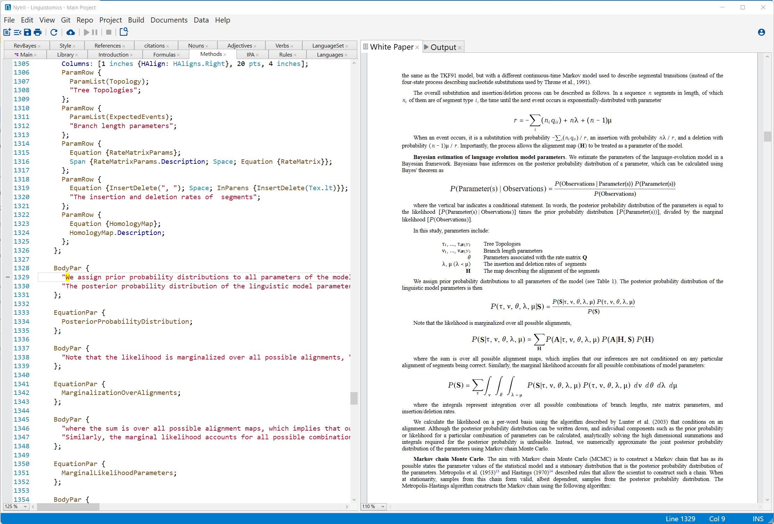

Slide 28
Tongue Twister 1.0
C++
Reads in initial alignments of cognates from JSON-formatted file.
Implements likelihood function of Lunter et al. (2003)
MCMC proposals for all parameters of the model, including the alignment of the cognates
Deals with incompletely sampled cognates using subtrees of a canonical tree with all 10 languages
Exponential of large rate matrix using Made method, and not the eigen system
Output of program can be used to reconstruct the posterior probability distribution of the model parameters

Slide 30
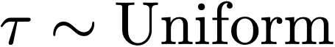
Priors on Model Parameters

Slide 31
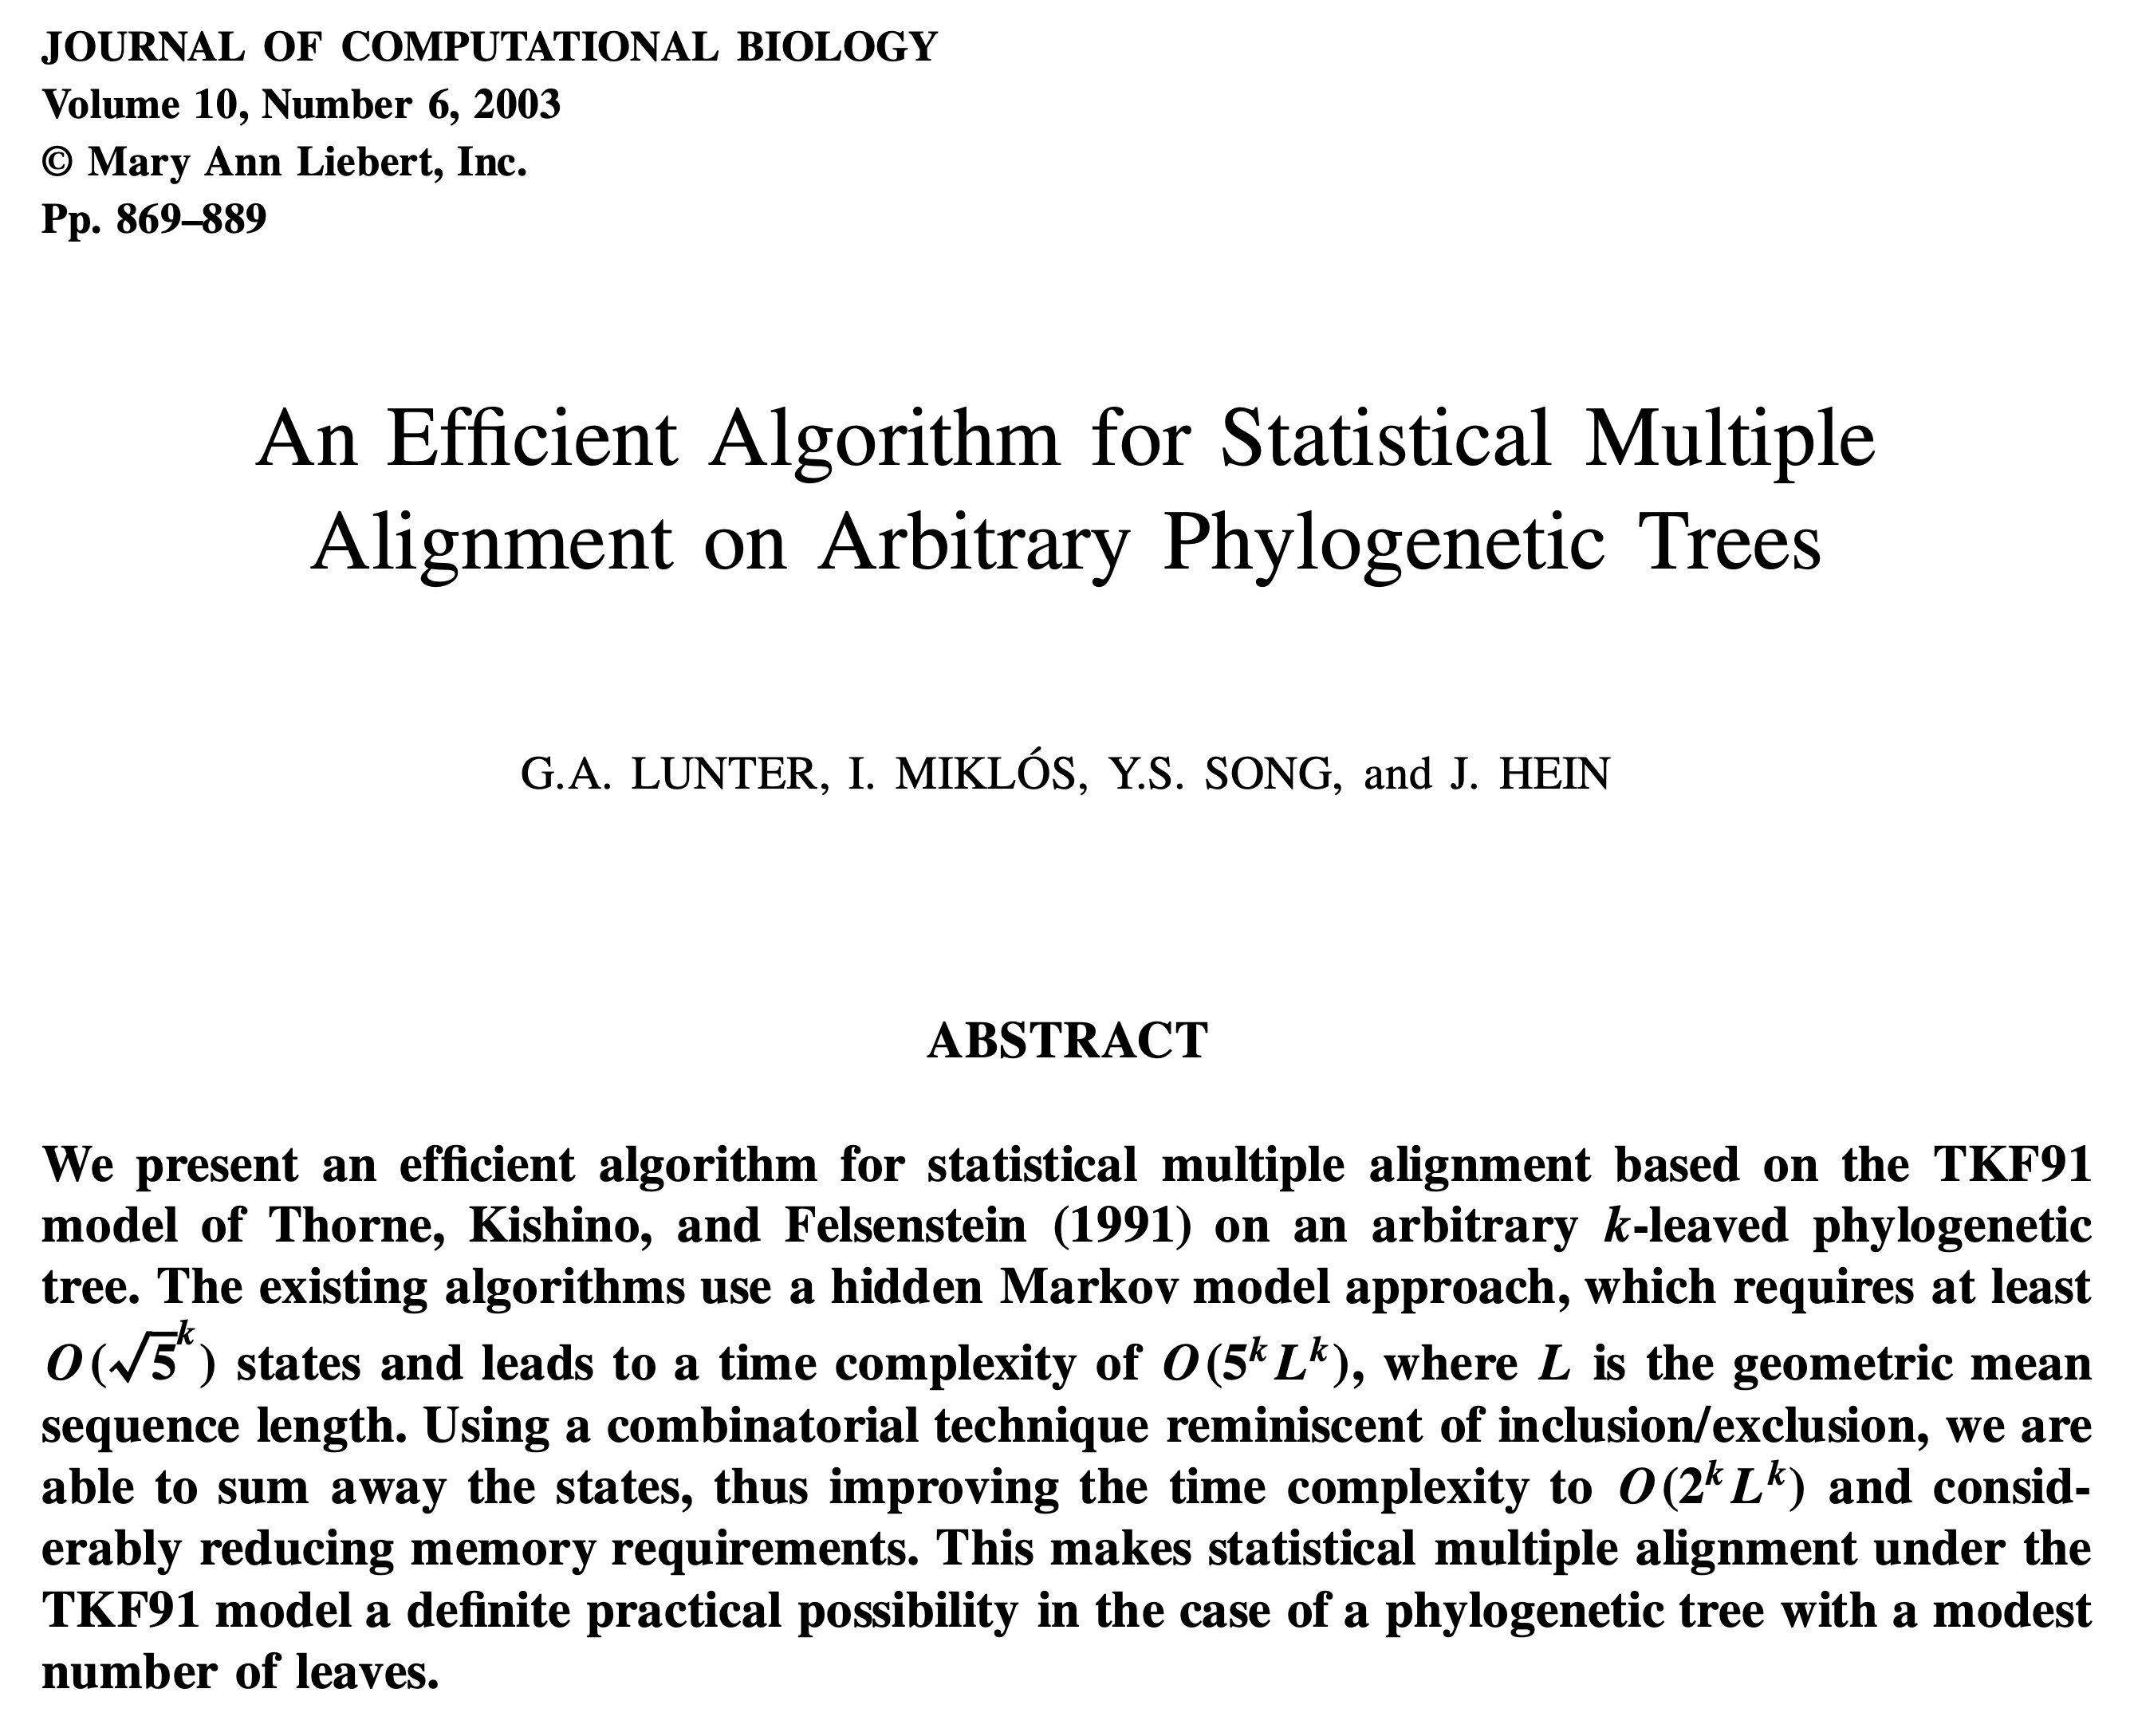

Slide 32
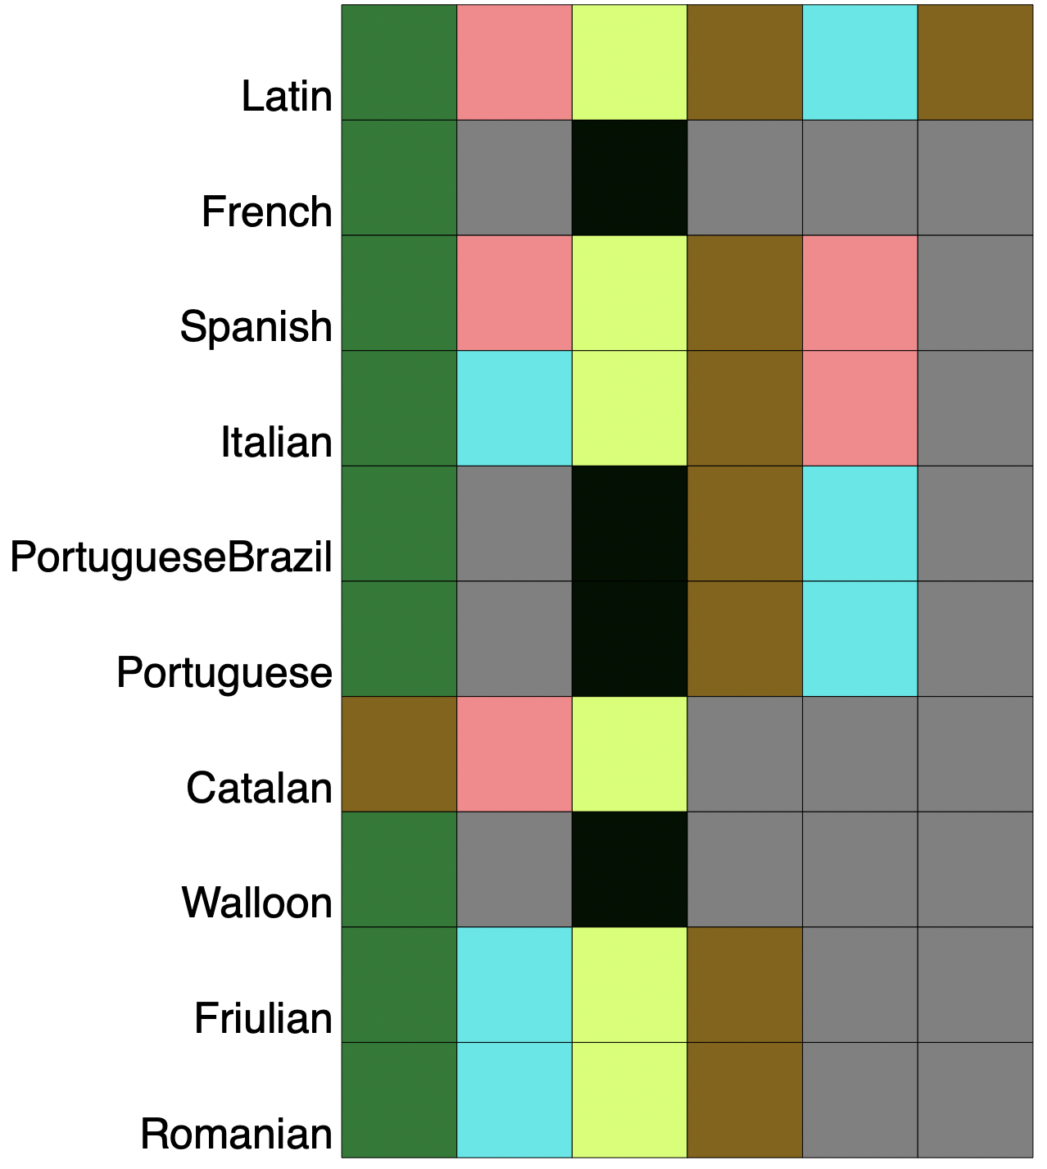
Pr( | Parameters)

Slide 33
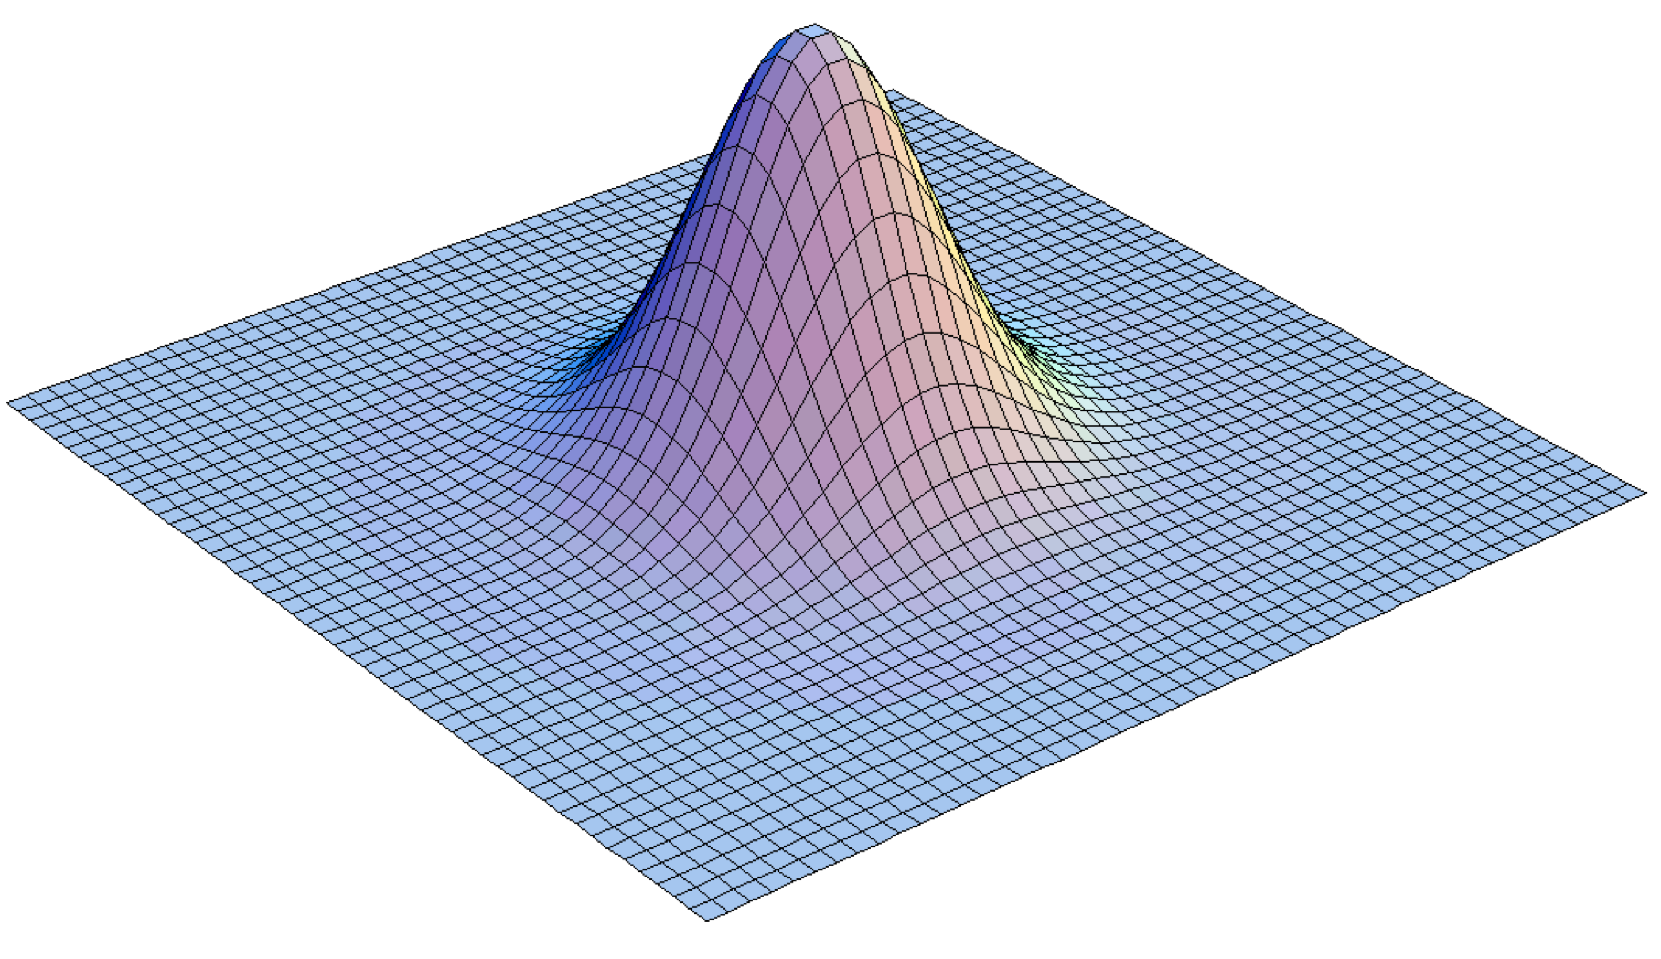
Markov chain Monte Carlo (MCMC)
Metropolis, N., A. Rosenblusth, M. Rosenbluth, A. Teller, E. Teller. 1953. Equations of state calculations by fast computing machines. J. Chem. Phys. 21:1087–1091.
Hastings, W. 1970. Monte Carlo sampling methods using Markov chains and their applications. Biometrika 57:97–109.

Slide 34
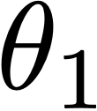
Markov chain Monte Carlo (MCMC)
Metropolis, N., A. Rosenblusth, M. Rosenbluth, A. Teller, E. Teller. 1953. Equations of state calculations by fast computing machines. J. Chem. Phys. 21:1087–1091.
Hastings, W. 1970. Monte Carlo sampling methods using Markov chains and their applications. Biometrika 57:97–109.

Slide 35
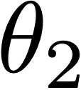
Markov chain Monte Carlo (MCMC)
Metropolis, N., A. Rosenblusth, M. Rosenbluth, A. Teller, E. Teller. 1953. Equations of state calculations by fast computing machines. J. Chem. Phys. 21:1087–1091.
Hastings, W. 1970. Monte Carlo sampling methods using Markov chains and their applications. Biometrika 57:97–109.

Slide 36
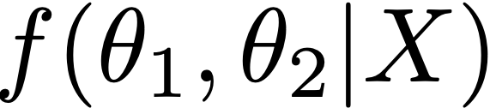
Markov chain Monte Carlo (MCMC)
Metropolis, N., A. Rosenblusth, M. Rosenbluth, A. Teller, E. Teller. 1953. Equations of state calculations by fast computing machines. J. Chem. Phys. 21:1087–1091.
Hastings, W. 1970. Monte Carlo sampling methods using Markov chains and their applications. Biometrika 57:97–109.

Slide 37
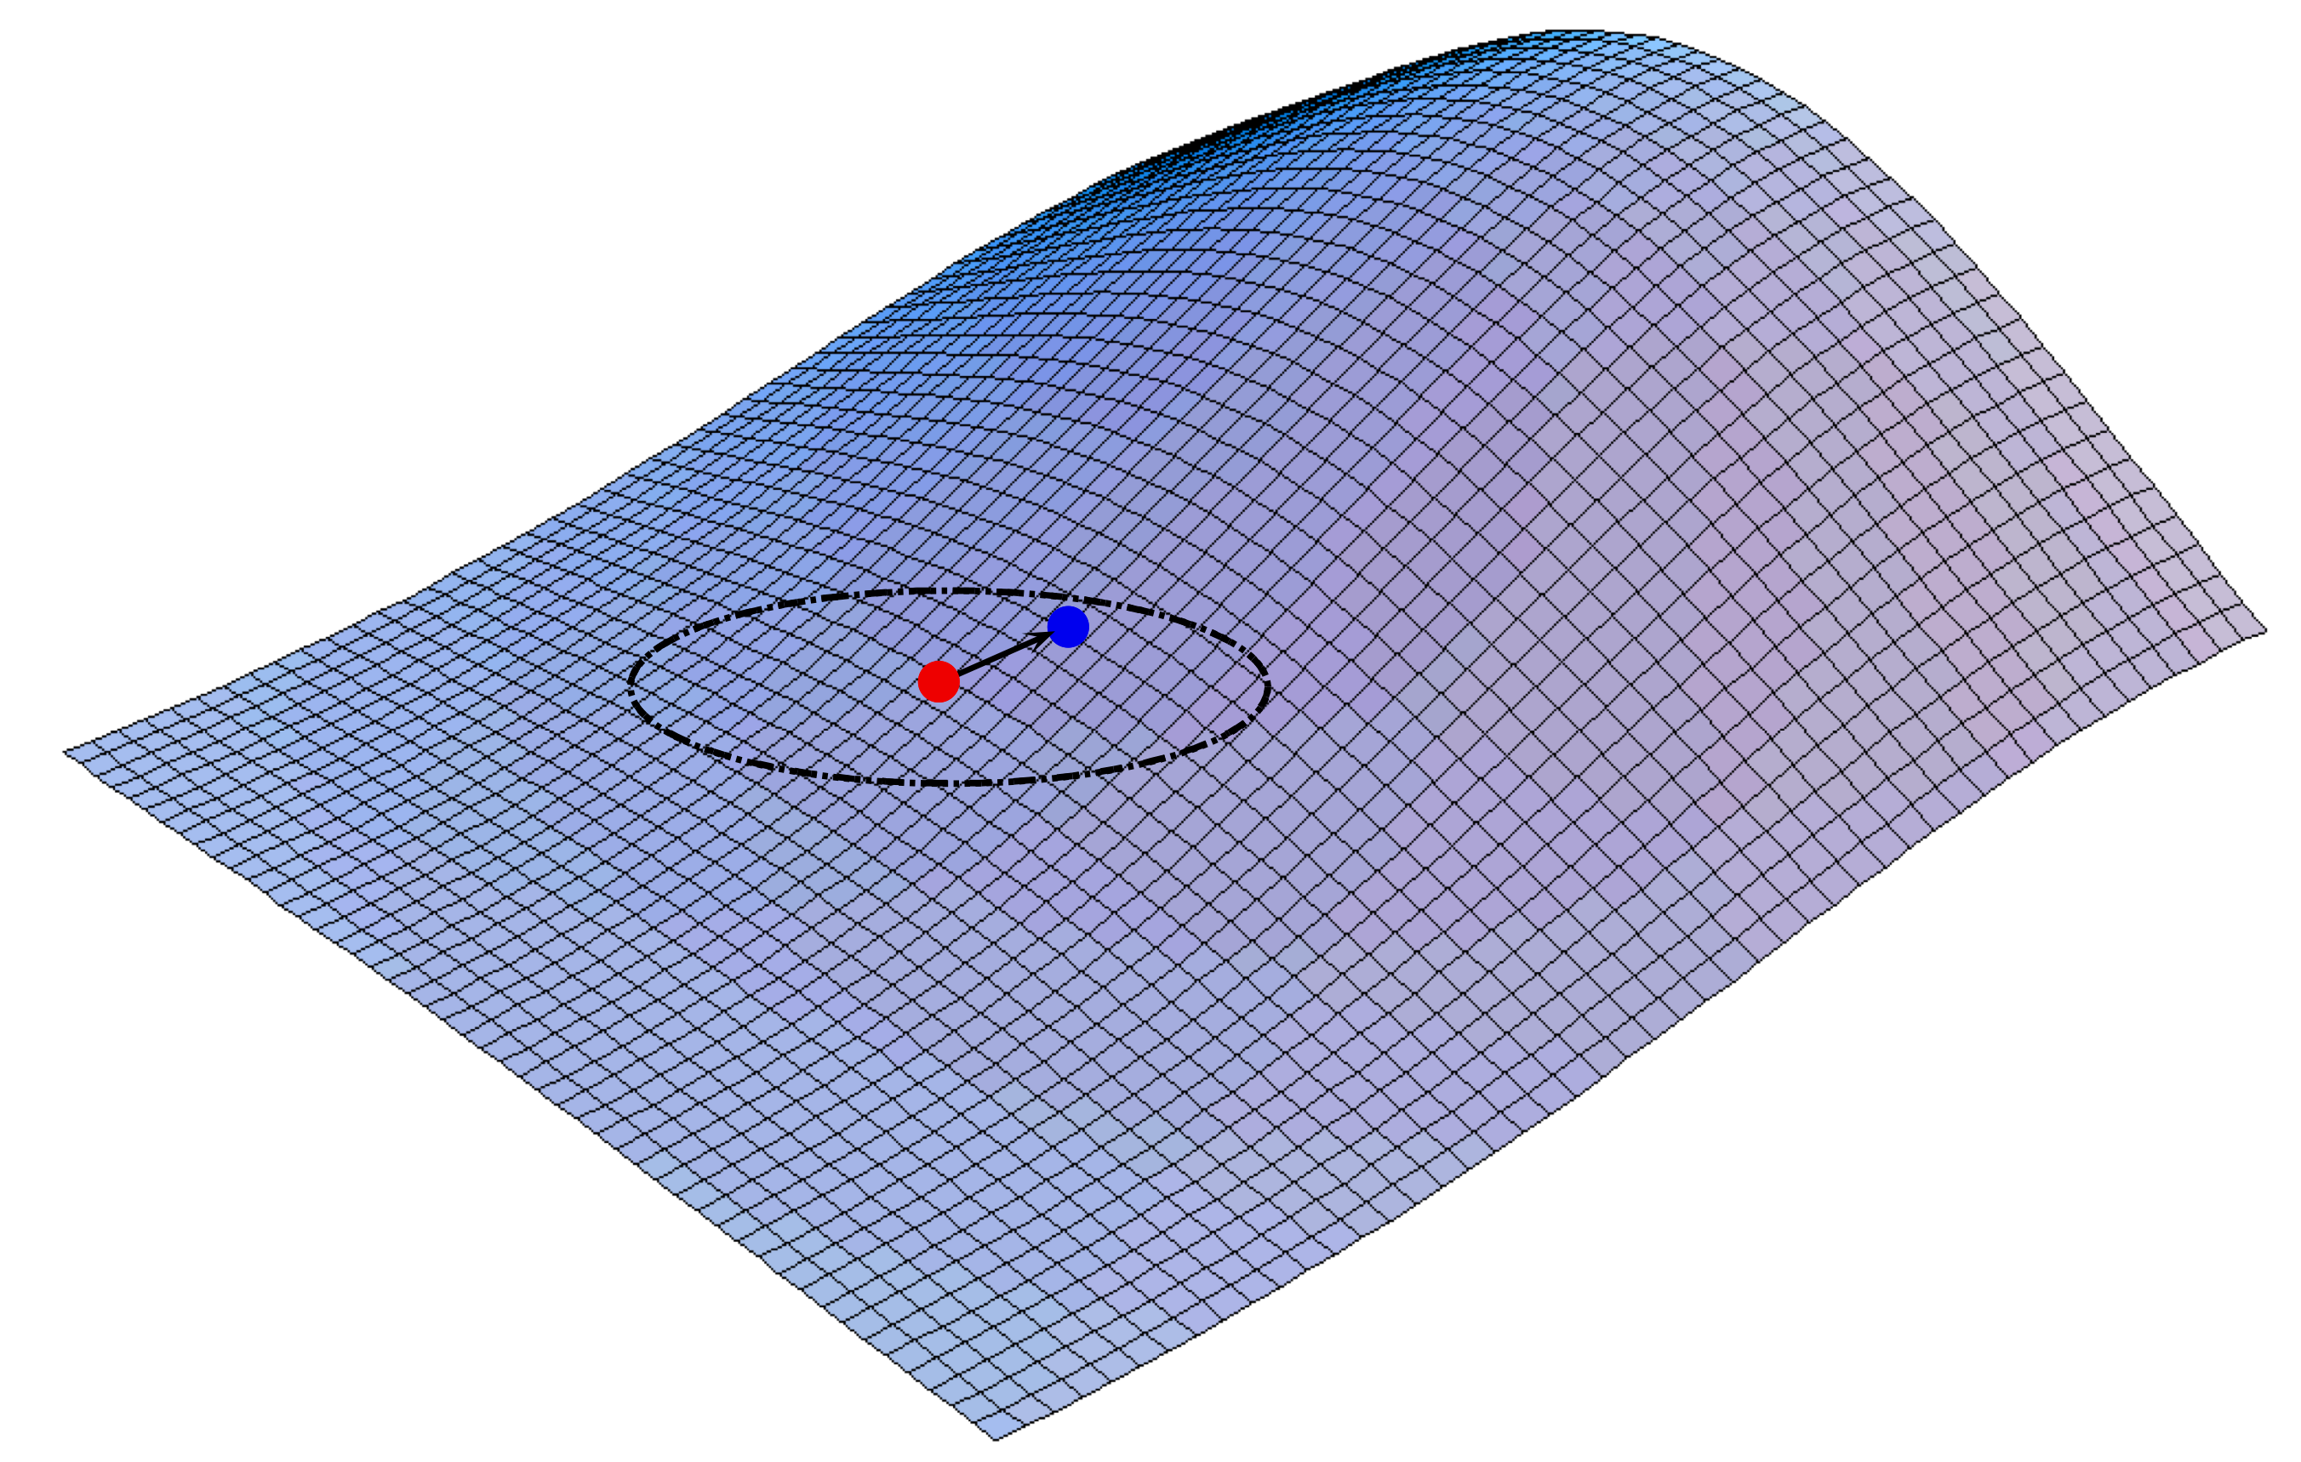

Slide 38
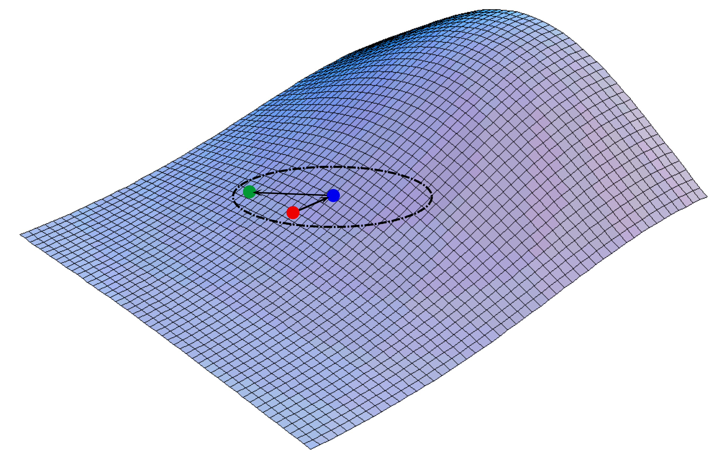

Slide 39
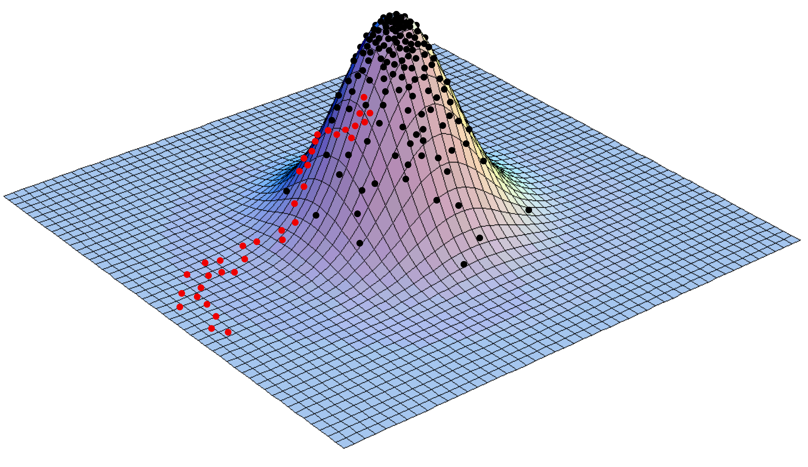

Slide 40
{
"Tree": "(Latin,(Romanian,(((Walloon,French),(((Portuguese,PortugueseBrazil),Spanish),Catalan)),(Friulian,Italian))));",
"NumberOfStates": 90,
"McmcSettings": {
"OnlyCompleteWords": "No",
"Model": “custom",
"CalcMarginal": "No",
"UseEigenSystem": "No",
"NumCycles": 400000,
"PrintFreq": 10,
"SampleFreq": 100,
"TreeLengthPriorVal": 0.15
},
"Taxa": ["Latin", "French", "Spanish", "Italian", "PortugueseBrazil", "Portuguese", "Catalan", "Walloon", "Friulian", "Romanian"],
"PartitionSets": [{"Name": "e", "Set": [1, 6]},{"Name": "i", "Set": [3, 20]},{"Name": "a", "Set": [5, 41]},{"Name": "u", "Set": [13, 60]},{"Name": "o", "Set": [17, 38]},{"Name": "ɛ", "Set": [12, 79]},{"Name": "ø", "Set": [73, 88]},{"Name": "Nasal Vowel", "Set": [27, 28, 29, 32, 42, 48, 52, 53, 56, 72, 84, 87]},{"Name": "Vowel", "Set": [9, 11, 23, 24, 25, 31, 43, 45, 46, 51, 55, 59, 62, 64, 65, 69, 74, 76, 78, 89]},{"Name": "Nasal Consonant", "Set": [2, 4, 22, 71, 86]},{"Name": "Non Sylabic Sonorant", "Set": [10, 14, 15, 47]},{"Name": "Consonant", "Set": [0, 7, 8, 16, 18, 19, 21, 26, 30, 33, 34, 35, 36, 37, 39, 40, 44, 49, 50, 54, 57, 58, 61, 63, 66, 67, 68, 70, 75, 77, 80, 81, 82, 83, 85]}],
"Words": [
{"Name": "Woman-Primary", "Data": [
{"Taxon": "Latin", "Segments": [0, 1, -1, 2, 3, -1, 4, -1, 5]},
{"Taxon": "French", "Segments": [0, 5, -1, 2, -1, -1, -1, -1, -1]},
{"Taxon": "Spanish", "Segments": [-1, 6, -1, 2, -1, 7, 8, -1, 5]},
{"Taxon": "Italian", "Segments": [0, 6, 2, 2, 3, -1, 4, -1, 5]},
{"Taxon": "PortugueseBrazil", "Segments": [0, 6, -1, 2, 6, -1, -1, -1, 9]},
{"Taxon": "Portuguese", "Segments": [0, 6, -1, 2, 10, -1, -1, -1, 9]},
{"Taxon": "Catalan", "Segments": [0, 6, -1, 2, -1, 7, 8, -1, 5]},
{"Taxon": "Walloon", "Segments": [0, 11, -1, 2, -1, -1, -1, -1, -1]},
{"Taxon": "Friulian", "Segments": [0, 12, -1, 2, 3, -1, 4, -1, 6]},
{"Taxon": "Romanian", "Segments": [0, 6, -1, 2, 6, -1, -1, 10, 6]}
]},
{"Name": "Woman-Mulier", "Data": [
{"Taxon": "Latin", "Segments": [2, 13, 14, 3, 6, 15, 6, 2]},
{"Taxon": "Spanish", "Segments": [2, 13, 16, -1, 6, 8, -1, -1]},
{"Taxon": "Italian", "Segments": [2, 17, 18, 18, 6, -1, -1, -1]},
{"Taxon": "PortugueseBrazil", "Segments": [2, 13, 18, -1, 6, 19, -1, -1]},
{"Taxon": "Portuguese", "Segments": [2, 13, 18, -1, 6, 8, -1, -1]},
{"Taxon": "Catalan", "Segments": [2, 13, 18, -1, 6, -1, -1, -1]},
{"Taxon": "Friulian", "Segments": [2, 13, -1, -1, 20, 15, -1, -1]},
{"Taxon": "Romanian", "Segments": [2, 13, -1, 10, 6, 15, 6, -1]}
]},
{"Name": "Woman-Domina", "Data": [
{"Taxon": "Latin", "Segments": [21, 17, 2, 3, 4, 5]},
{"Taxon": "French", "Segments": [21, 5, 2, -1, -1, -1]},
{"Taxon": "Spanish", "Segments": [21, 17, -1, -1, 22, 5]},
{"Taxon": "Italian", "Segments": [21, 23, 4, -1, 4, 5]},
{"Taxon": "PortugueseBrazil", "Segments": [21, 17, -1, -1, 4, 9]},
{"Taxon": "Portuguese", "Segments": [21, 17, -1, -1, 4, 9]},
{"Taxon": "Catalan", "Segments": [21, 23, -1, -1, 4, 24]},
{"Taxon": "Walloon", "Segments": [21, 5, 2, -1, -1, -1]},
{"Taxon": "Friulian", "Segments": [21, 23, -1, -1, 4, 6]},
{"Taxon": "Romanian", "Segments": [21, 25, 2, -1, 4, 24]}
]},
{"Name": "Child-Primary", "Data": [
{"Taxon": "Latin", "Segments": [3, 4, 0, 5, 4, 26, 6, 2]},
{"Taxon": "French", "Segments": [27, -1, 0, 27, -1, -1, -1, -1]},
{"Taxon": "Spanish", "Segments": [3, 4, 0, 5, 4, 26, 6, -1]},
{"Taxon": "Italian", "Segments": [-1, -1, 0, 5, 4, 26, 6, -1]},
{"Taxon": "PortugueseBrazil", "Segments": [28, -1, 0, 29, -1, 30, 3, -1]},
{"Taxon": "Portuguese", "Segments": [28, -1, 0, 29, -1, 26, 31, -1]},
{"Taxon": "Walloon", "Segments": [12, -1, 0, 27, -1, -1, -1, -1]}
]},

Slide 41


{
"Tree": "(Latin,(Romanian,(((Walloon,French),(((Portuguese,PortugueseBrazil),Spanish),Catalan)),(Friulian,Italian))));",
"NumberOfStates": 90,
"McmcSettings": {
"OnlyCompleteWords": "No",
"Model": “custom",
"CalcMarginal": "No",
"UseEigenSystem": "No",
"NumCycles": 400000,
"PrintFreq": 10,
"SampleFreq": 100,
"TreeLengthPriorVal": 0.15
},
"Taxa": ["Latin", "French", "Spanish", "Italian", "PortugueseBrazil", "Portuguese", "Catalan", "Walloon", "Friulian", "Romanian"],
"PartitionSets": [{"Name": "e", "Set": [1, 6]},{"Name": "i", "Set": [3, 20]},{"Name": "a", "Set": [5, 41]},{"Name": "u", "Set": [13, 60]},{"Name": "o", "Set": [17, 38]},{"Name": "ɛ", "Set": [12, 79]},{"Name": "ø", "Set": [73, 88]},{"Name": "Nasal Vowel", "Set": [27, 28, 29, 32, 42, 48, 52, 53, 56, 72, 84, 87]},{"Name": "Vowel", "Set": [9, 11, 23, 24, 25, 31, 43, 45, 46, 51, 55, 59, 62, 64, 65, 69, 74, 76, 78, 89]},{"Name": "Nasal Consonant", "Set": [2, 4, 22, 71, 86]},{"Name": "Non Sylabic Sonorant", "Set": [10, 14, 15, 47]},{"Name": "Consonant", "Set": [0, 7, 8, 16, 18, 19, 21, 26, 30, 33, 34, 35, 36, 37, 39, 40, 44, 49, 50, 54, 57, 58, 61, 63, 66, 67, 68, 70, 75, 77, 80, 81, 82, 83, 85]}],
"Words": [
{"Name": "Woman-Primary", "Data": [
{"Taxon": "Latin", "Segments": [0, 1, -1, 2, 3, -1, 4, -1, 5]},
{"Taxon": "French", "Segments": [0, 5, -1, 2, -1, -1, -1, -1, -1]},
{"Taxon": "Spanish", "Segments": [-1, 6, -1, 2, -1, 7, 8, -1, 5]},
{"Taxon": "Italian", "Segments": [0, 6, 2, 2, 3, -1, 4, -1, 5]},
{"Taxon": "PortugueseBrazil", "Segments": [0, 6, -1, 2, 6, -1, -1, -1, 9]},
{"Taxon": "Portuguese", "Segments": [0, 6, -1, 2, 10, -1, -1, -1, 9]},
{"Taxon": "Catalan", "Segments": [0, 6, -1, 2, -1, 7, 8, -1, 5]},
{"Taxon": "Walloon", "Segments": [0, 11, -1, 2, -1, -1, -1, -1, -1]},
{"Taxon": "Friulian", "Segments": [0, 12, -1, 2, 3, -1, 4, -1, 6]},
{"Taxon": "Romanian", "Segments": [0, 6, -1, 2, 6, -1, -1, 10, 6]}
]},
{"Name": "Woman-Mulier", "Data": [
{"Taxon": "Latin", "Segments": [2, 13, 14, 3, 6, 15, 6, 2]},
{"Taxon": "Spanish", "Segments": [2, 13, 16, -1, 6, 8, -1, -1]},
{"Taxon": "Italian", "Segments": [2, 17, 18, 18, 6, -1, -1, -1]},
{"Taxon": "PortugueseBrazil", "Segments": [2, 13, 18, -1, 6, 19, -1, -1]},
{"Taxon": "Portuguese", "Segments": [2, 13, 18, -1, 6, 8, -1, -1]},
{"Taxon": "Catalan", "Segments": [2, 13, 18, -1, 6, -1, -1, -1]},
{"Taxon": "Friulian", "Segments": [2, 13, -1, -1, 20, 15, -1, -1]},
{"Taxon": "Romanian", "Segments": [2, 13, -1, 10, 6, 15, 6, -1]}
]},
{"Name": "Woman-Domina", "Data": [
{"Taxon": "Latin", "Segments": [21, 17, 2, 3, 4, 5]},
{"Taxon": "French", "Segments": [21, 5, 2, -1, -1, -1]},
{"Taxon": "Spanish", "Segments": [21, 17, -1, -1, 22, 5]},
{"Taxon": "Italian", "Segments": [21, 23, 4, -1, 4, 5]},
{"Taxon": "PortugueseBrazil", "Segments": [21, 17, -1, -1, 4, 9]},
{"Taxon": "Portuguese", "Segments": [21, 17, -1, -1, 4, 9]},
{"Taxon": "Catalan", "Segments": [21, 23, -1, -1, 4, 24]},
{"Taxon": "Walloon", "Segments": [21, 5, 2, -1, -1, -1]},
{"Taxon": "Friulian", "Segments": [21, 23, -1, -1, 4, 6]},
{"Taxon": "Romanian", "Segments": [21, 25, 2, -1, 4, 24]}
]},
{"Name": "Child-Primary", "Data": [
{"Taxon": "Latin", "Segments": [3, 4, 0, 5, 4, 26, 6, 2]},
{"Taxon": "French", "Segments": [27, -1, 0, 27, -1, -1, -1, -1]},
{"Taxon": "Spanish", "Segments": [3, 4, 0, 5, 4, 26, 6, -1]},
{"Taxon": "Italian", "Segments": [-1, -1, 0, 5, 4, 26, 6, -1]},
{"Taxon": "PortugueseBrazil", "Segments": [28, -1, 0, 29, -1, 30, 3, -1]},
{"Taxon": "Portuguese", "Segments": [28, -1, 0, 29, -1, 26, 31, -1]},
{"Taxon": "Walloon", "Segments": [12, -1, 0, 27, -1, -1, -1, -1]}
]},
340 cognates analyzed. (Of a total of
367 in the data file, 340 had information
for at least three languages.)

Slide 42
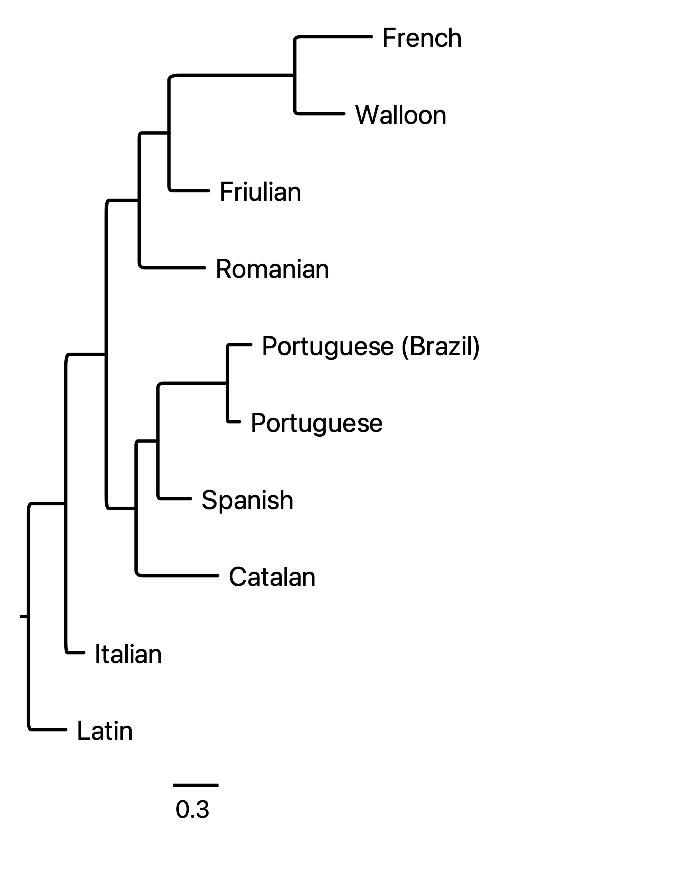

Slide 44
A little on partitioning the 90 states
At the highest level, we partition word segment states by vowels and consonants.
The subsets “nasal consonants,” non-syllabic consonants,” and “consonants” together form the consonants grouping.
The remaining subsets constitute vowels.
At a more fine-scale level, subsets are based on phonetic similarities/dissimilarities. For example, nasalized v. non-nasalized or short v. long versions of the same vowel/consonant.

Slide 45
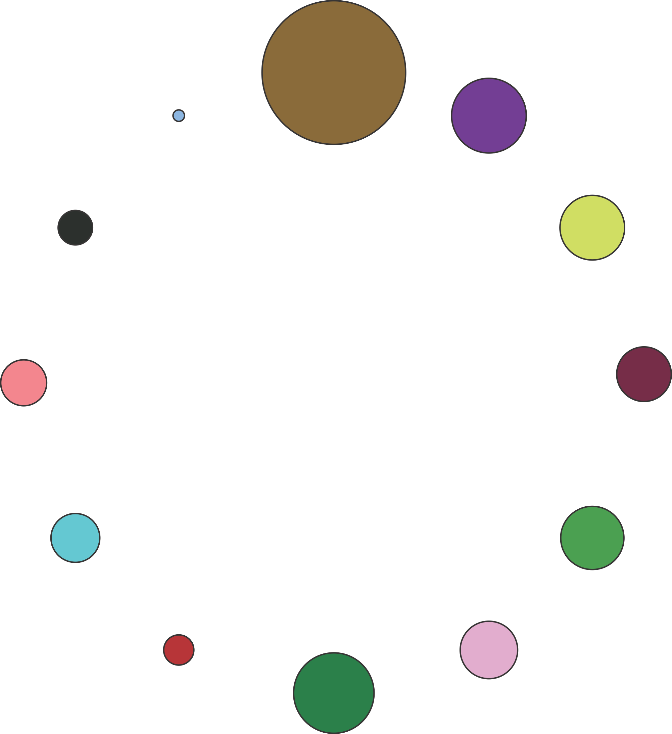

Consonant
ø
e
Nasal Vowel
Nasal Consonant
o
i
u
a
ɛ
Vowel
Non Syllabic Sonorant

Slide 46
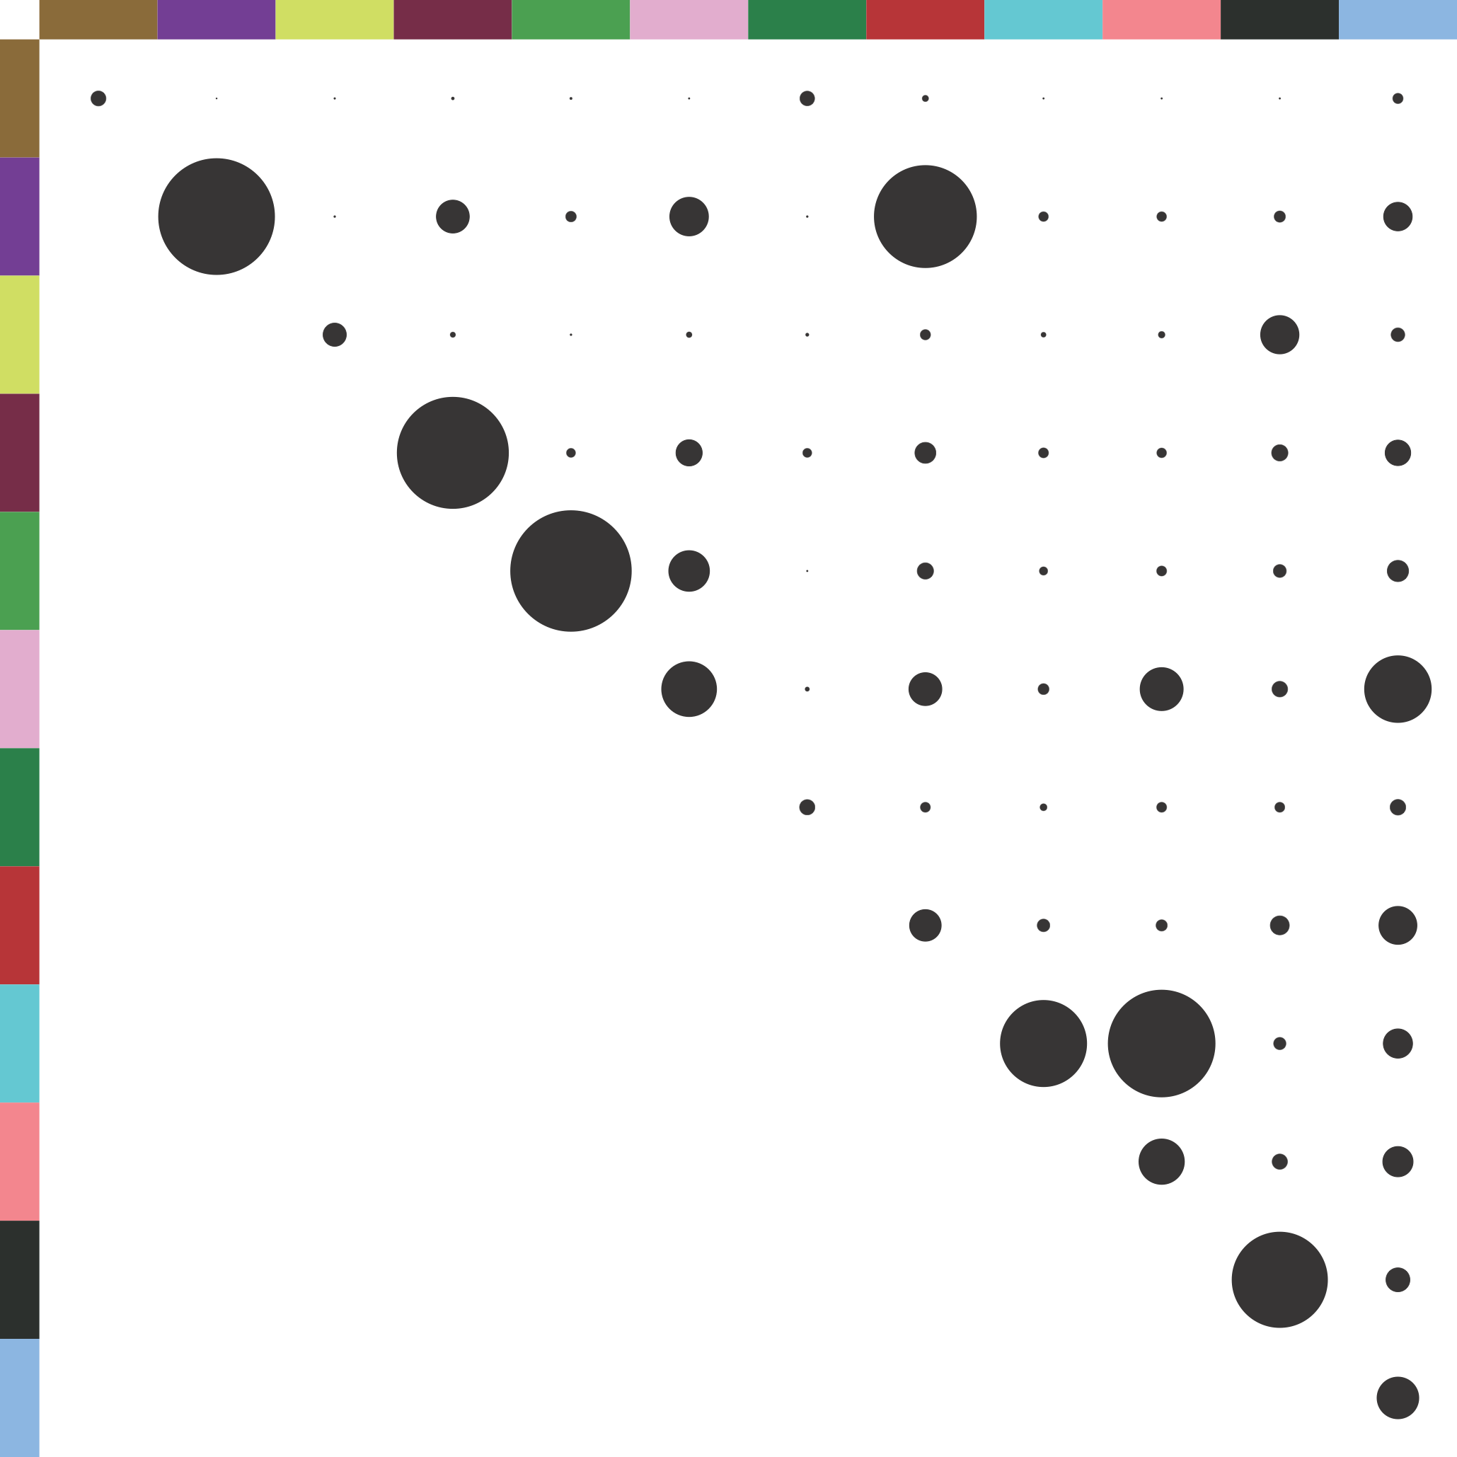
Consonant
e
Nasal Consonant
i
a
Vowel
Non Syllabic Sonorant
ɛ
u
o
Nasal Vowel
ø

Slide 47

Consonant
e
Nasal Consonant
i
a
Vowel
Non Syllabic Sonorant
ɛ
u
o
Similar sound! Both substitutions are
“lowering processes,” with the jaw
lowered when pronounced.
Nasal Vowel
ø

Slide 48
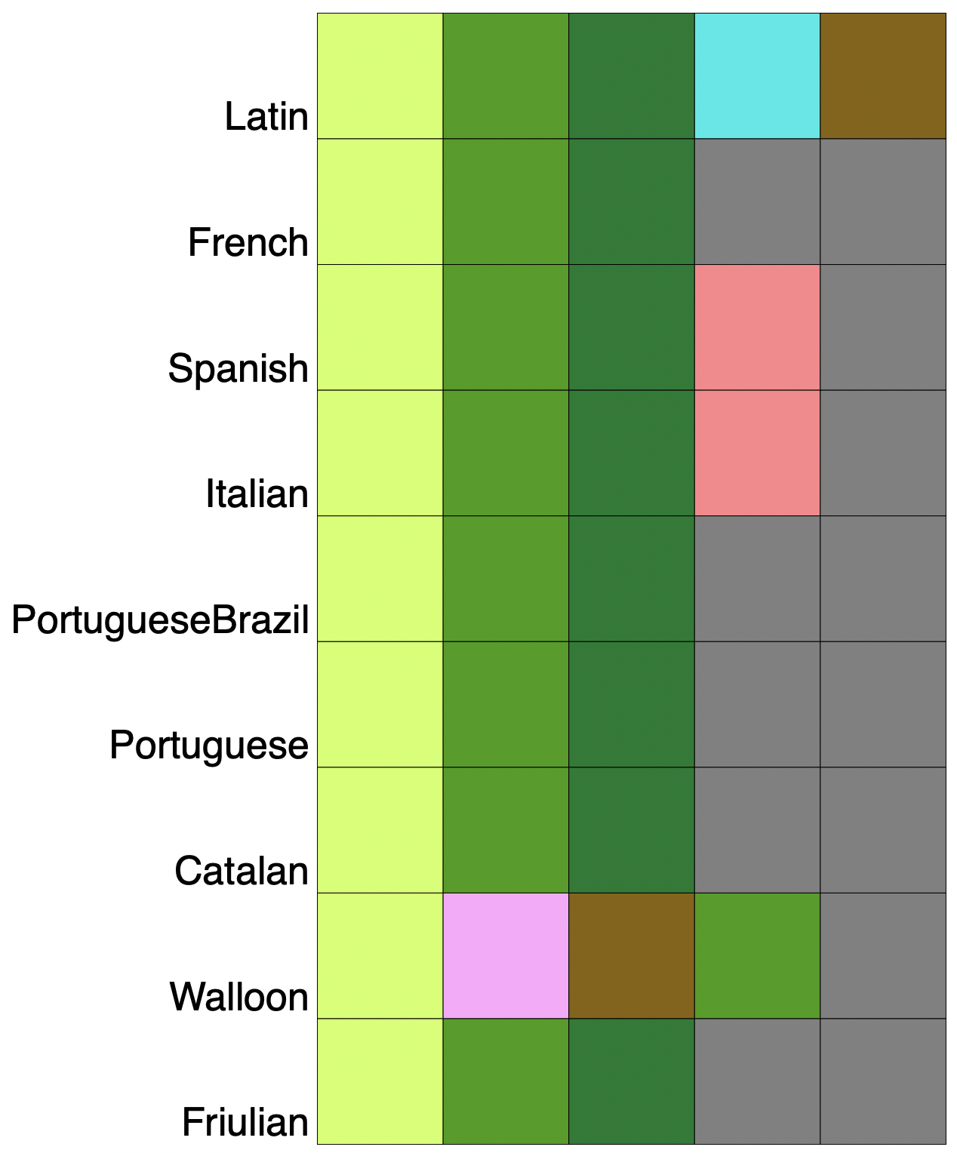
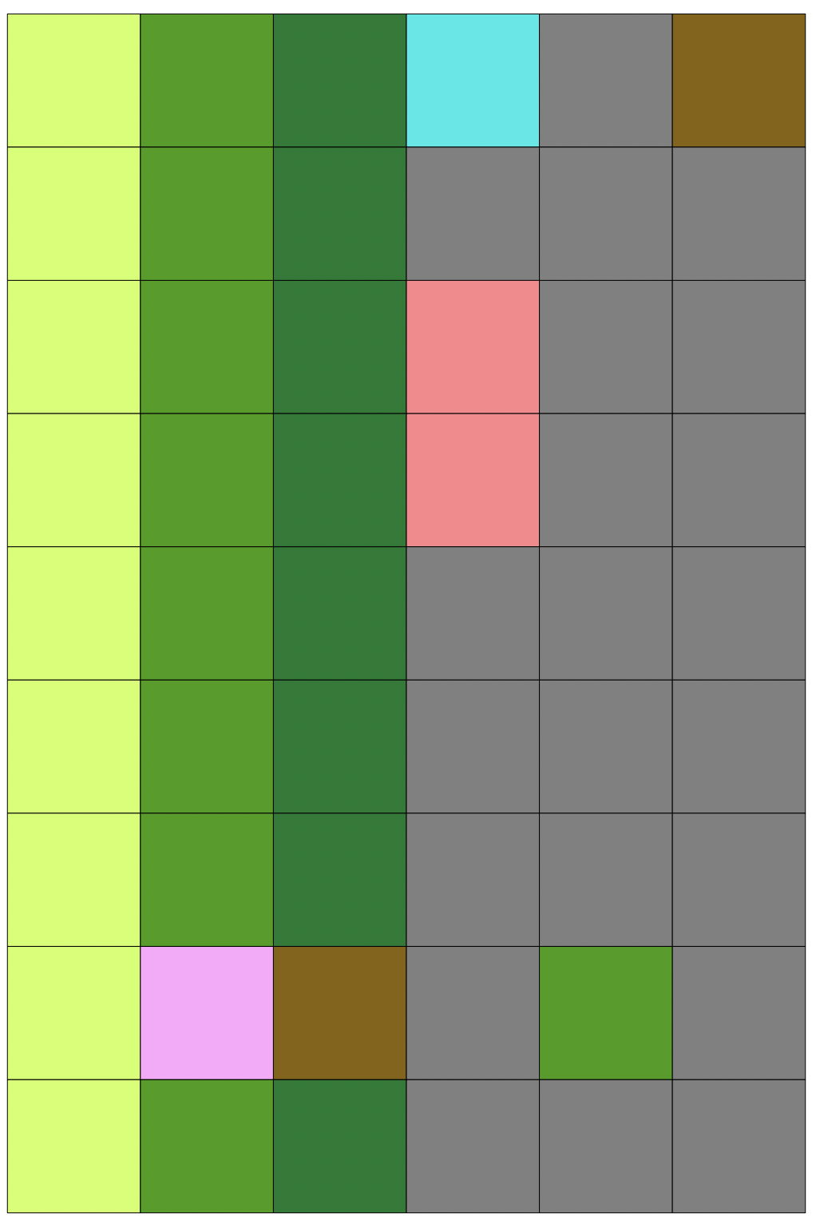
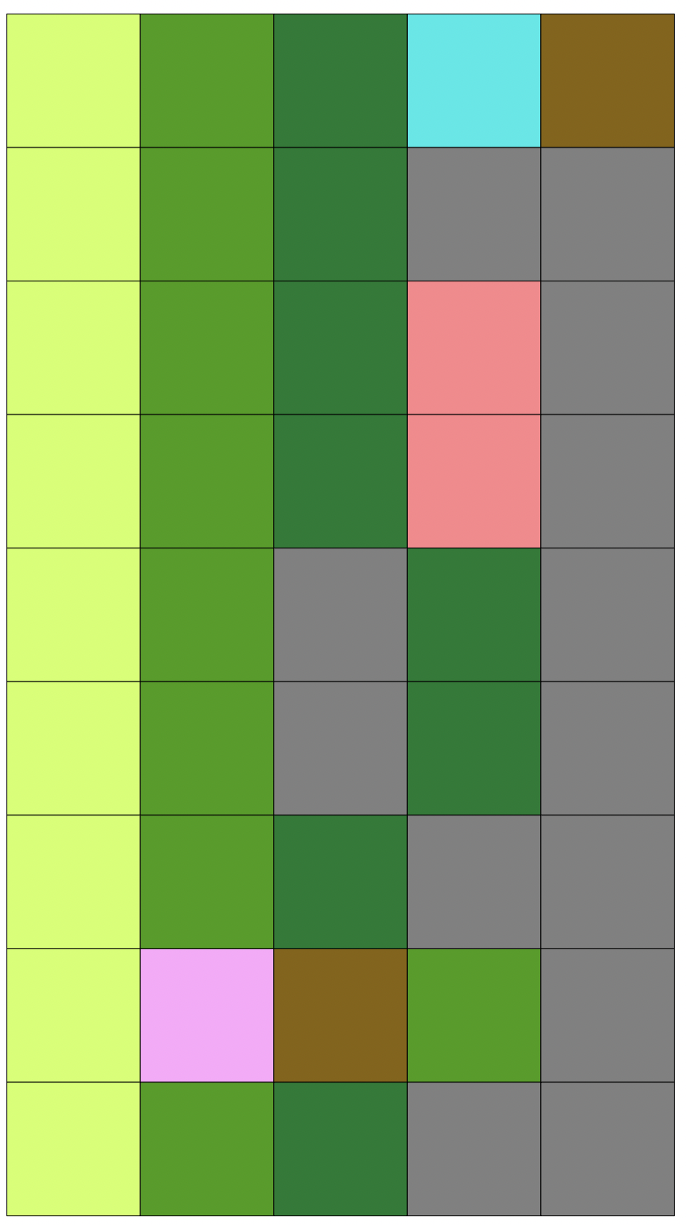
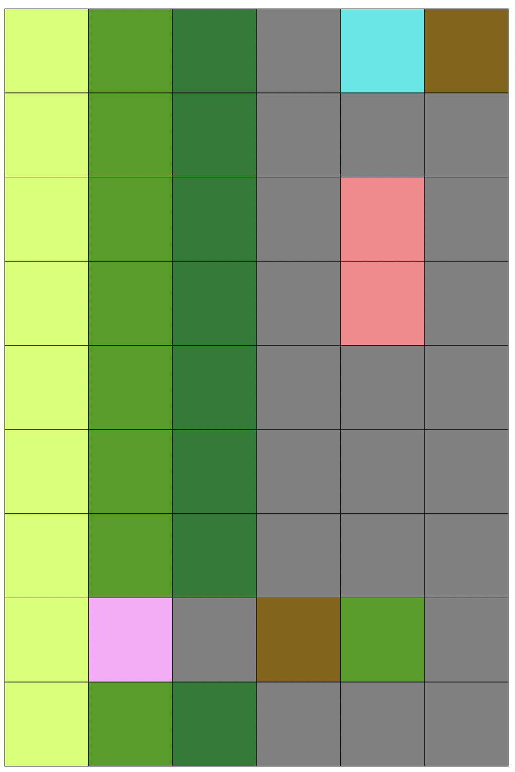
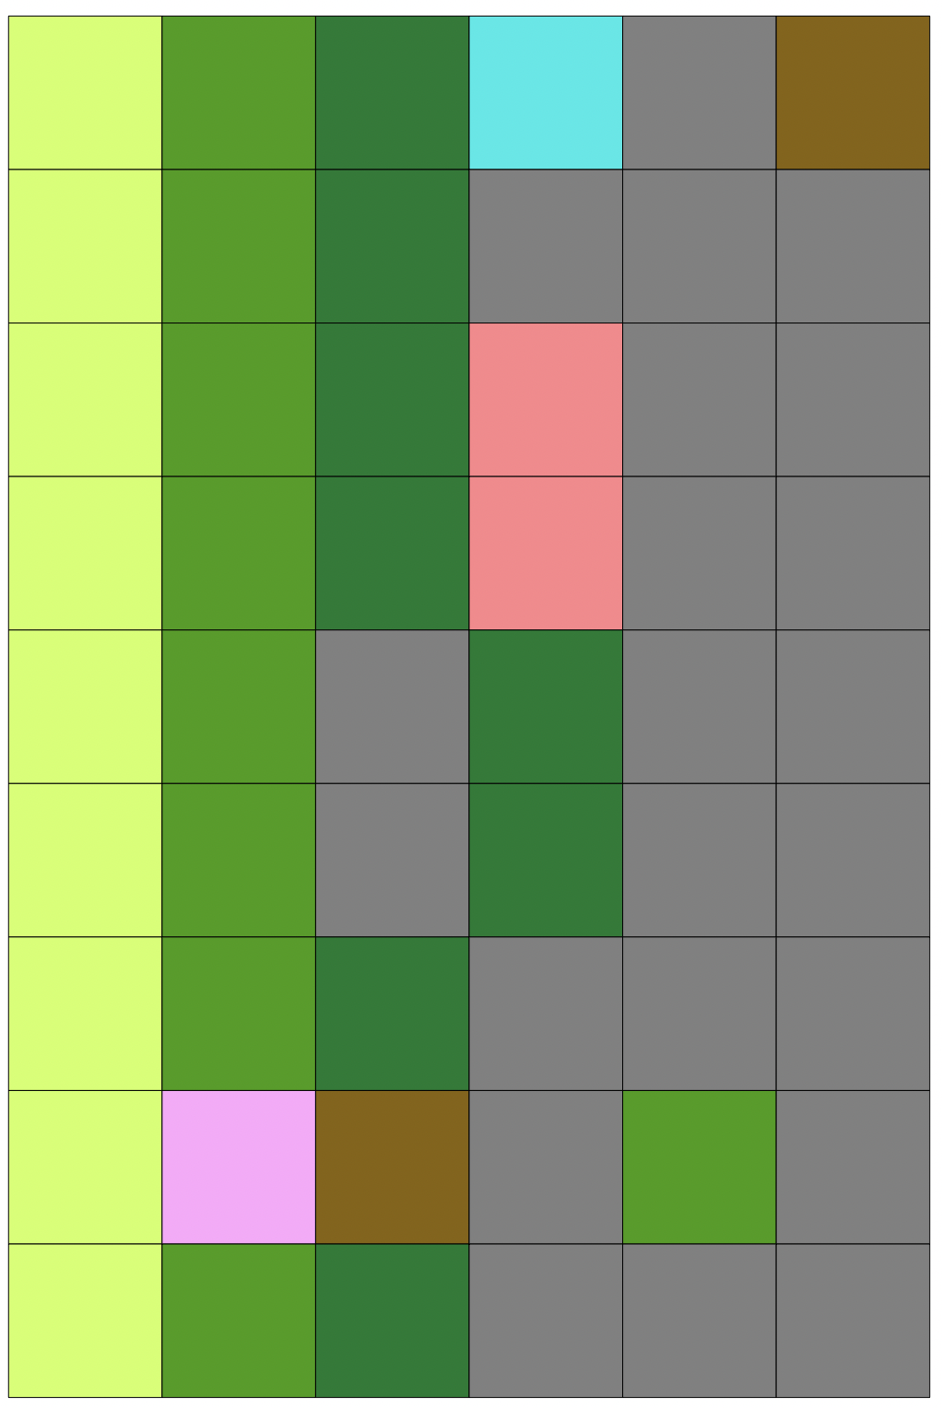
Cognate: Bad
Alignment 1
(0.550)
Alignment 2
(0.189)
Alignment 3
(0.088)
Alignment 4
(0.084)
Alignment 5
(0.041)
0.550
0.739
0.826
0.910
0.951

Slide 49
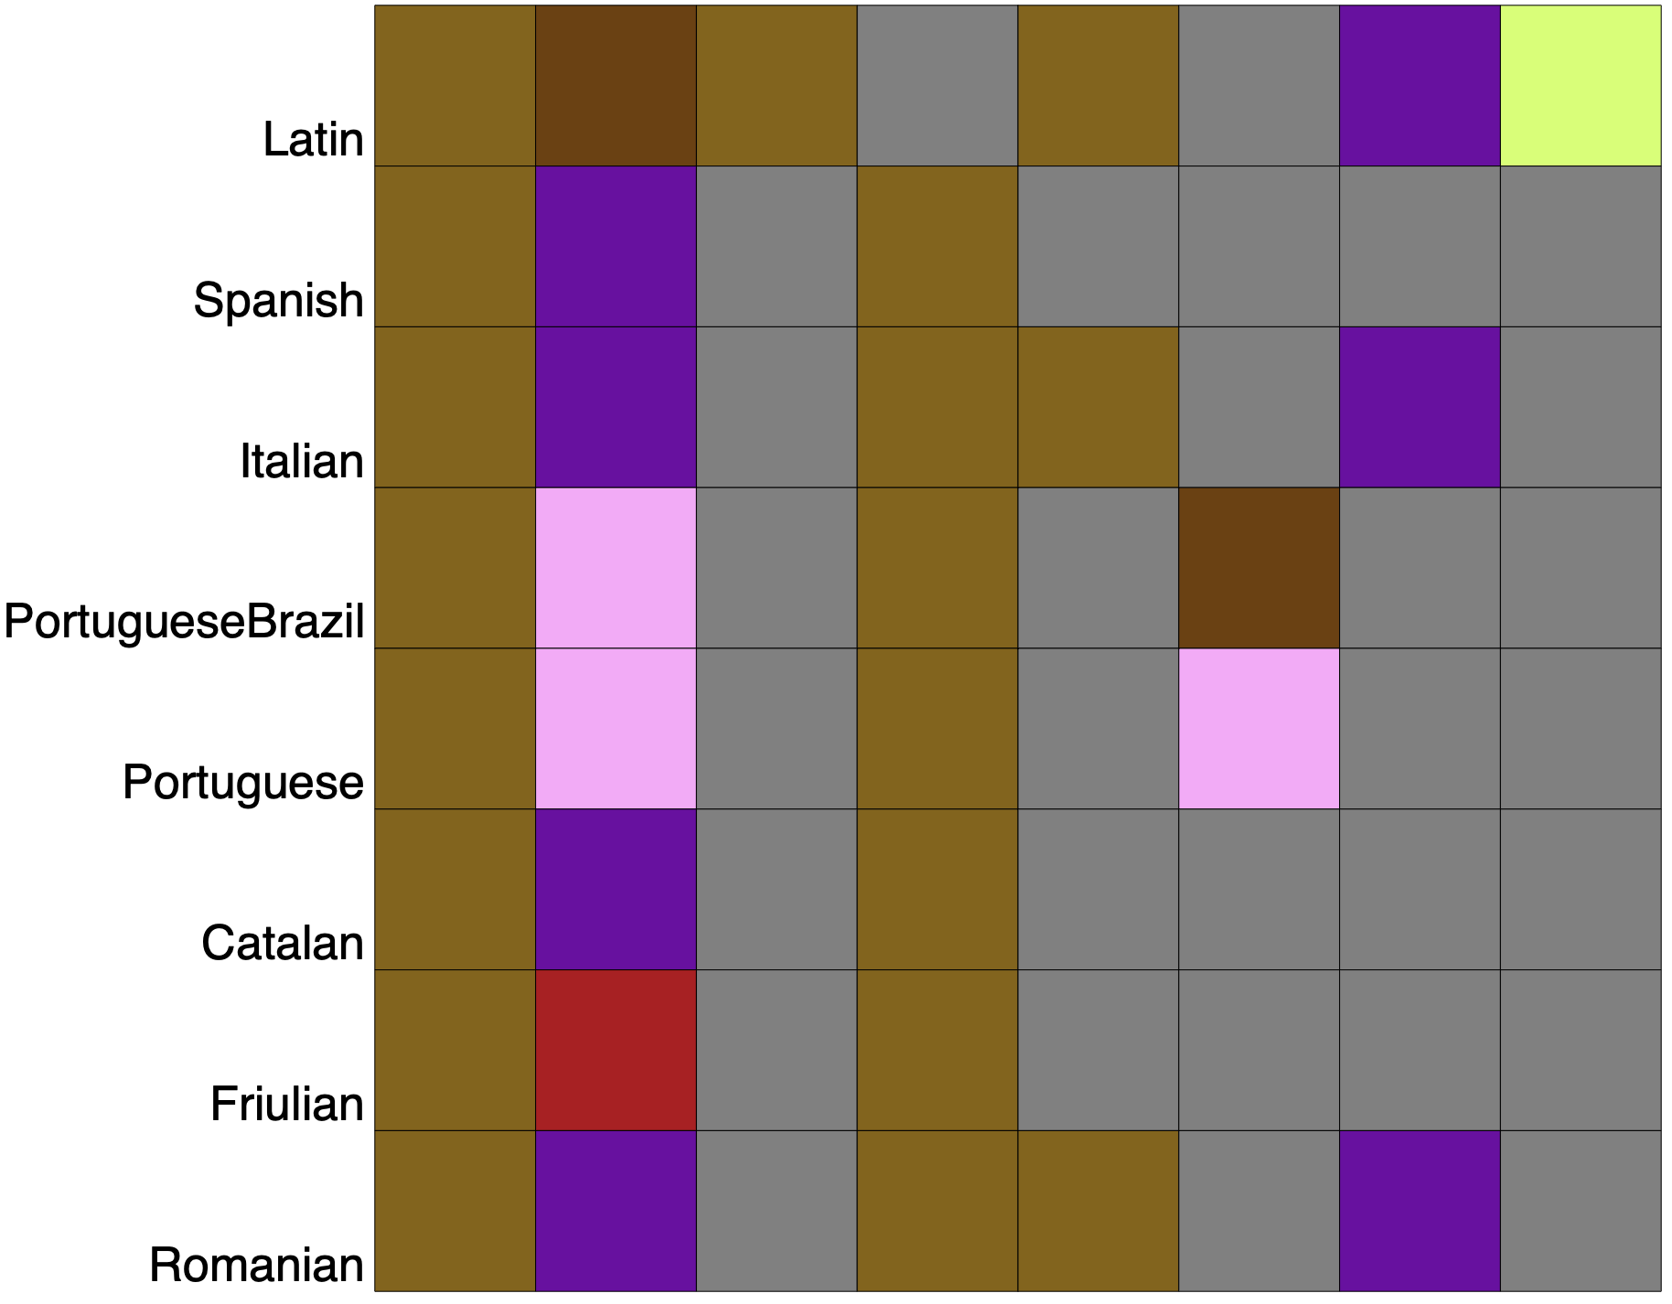
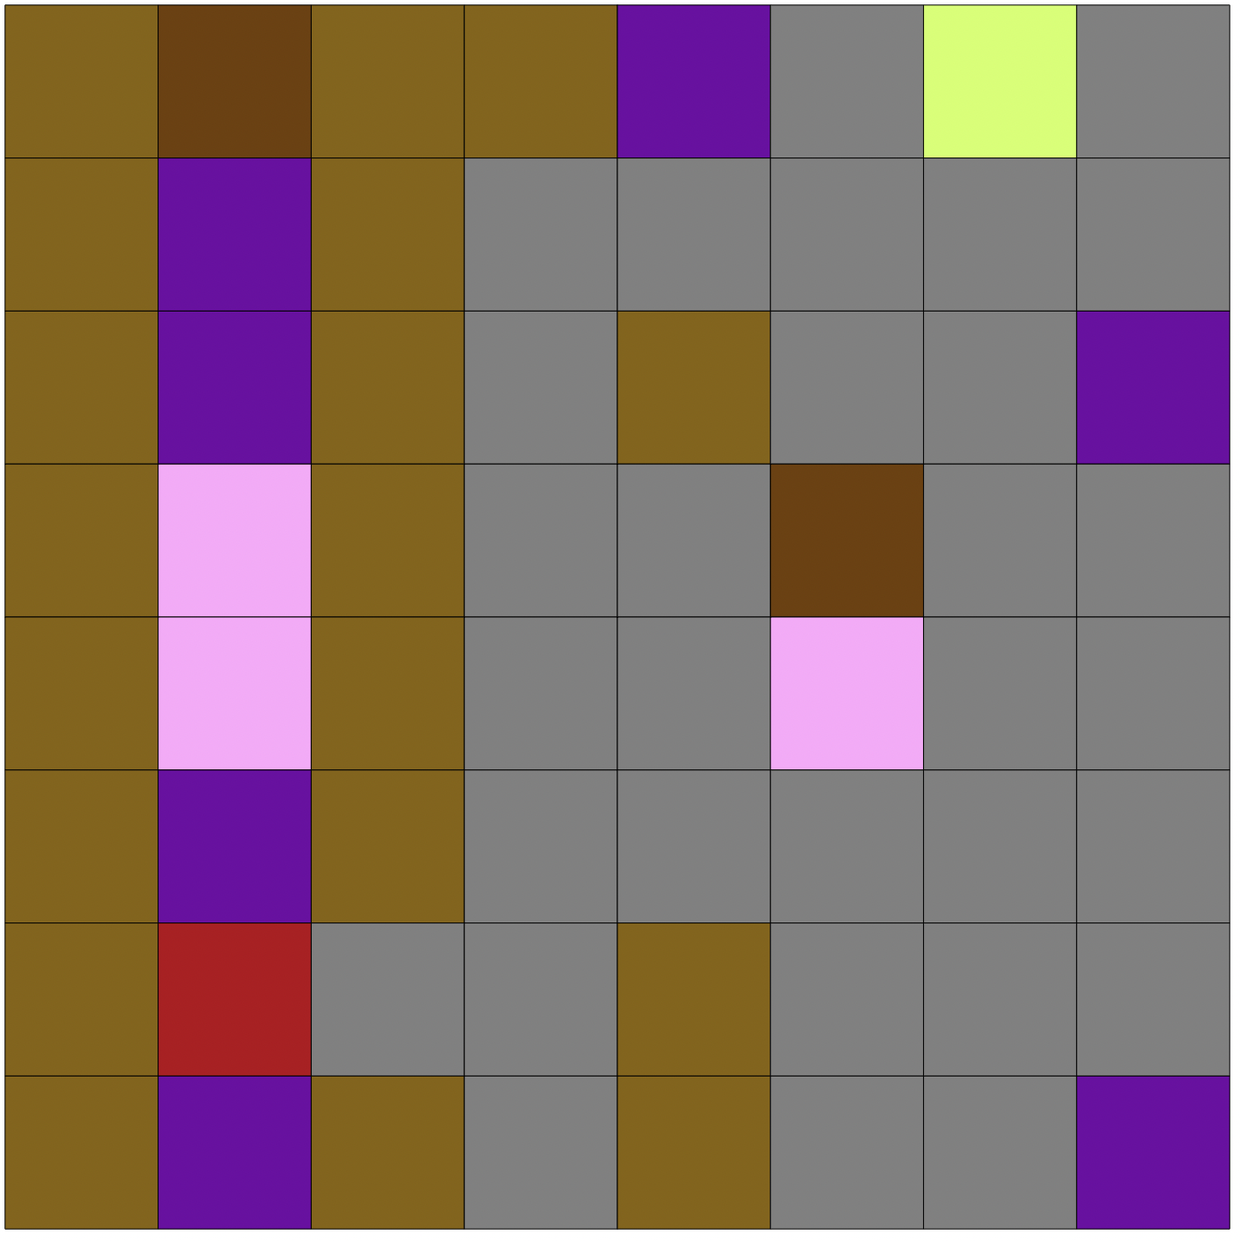
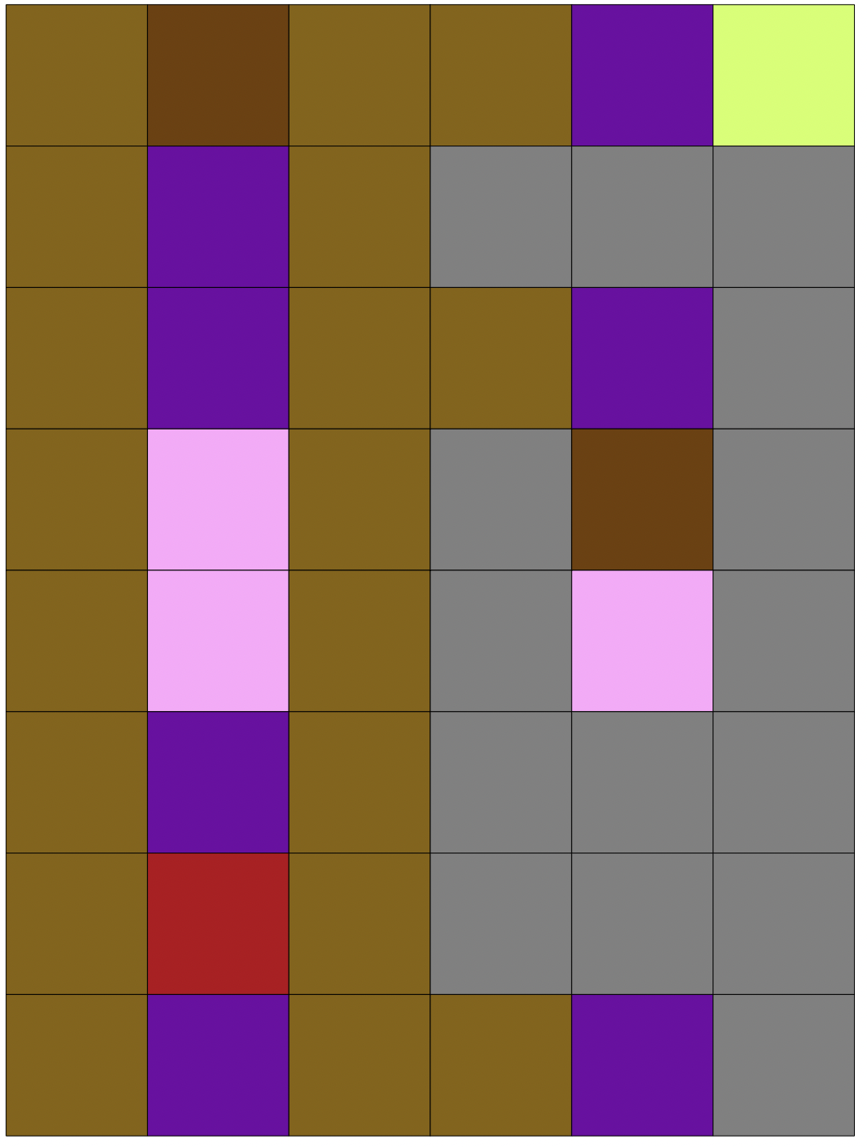
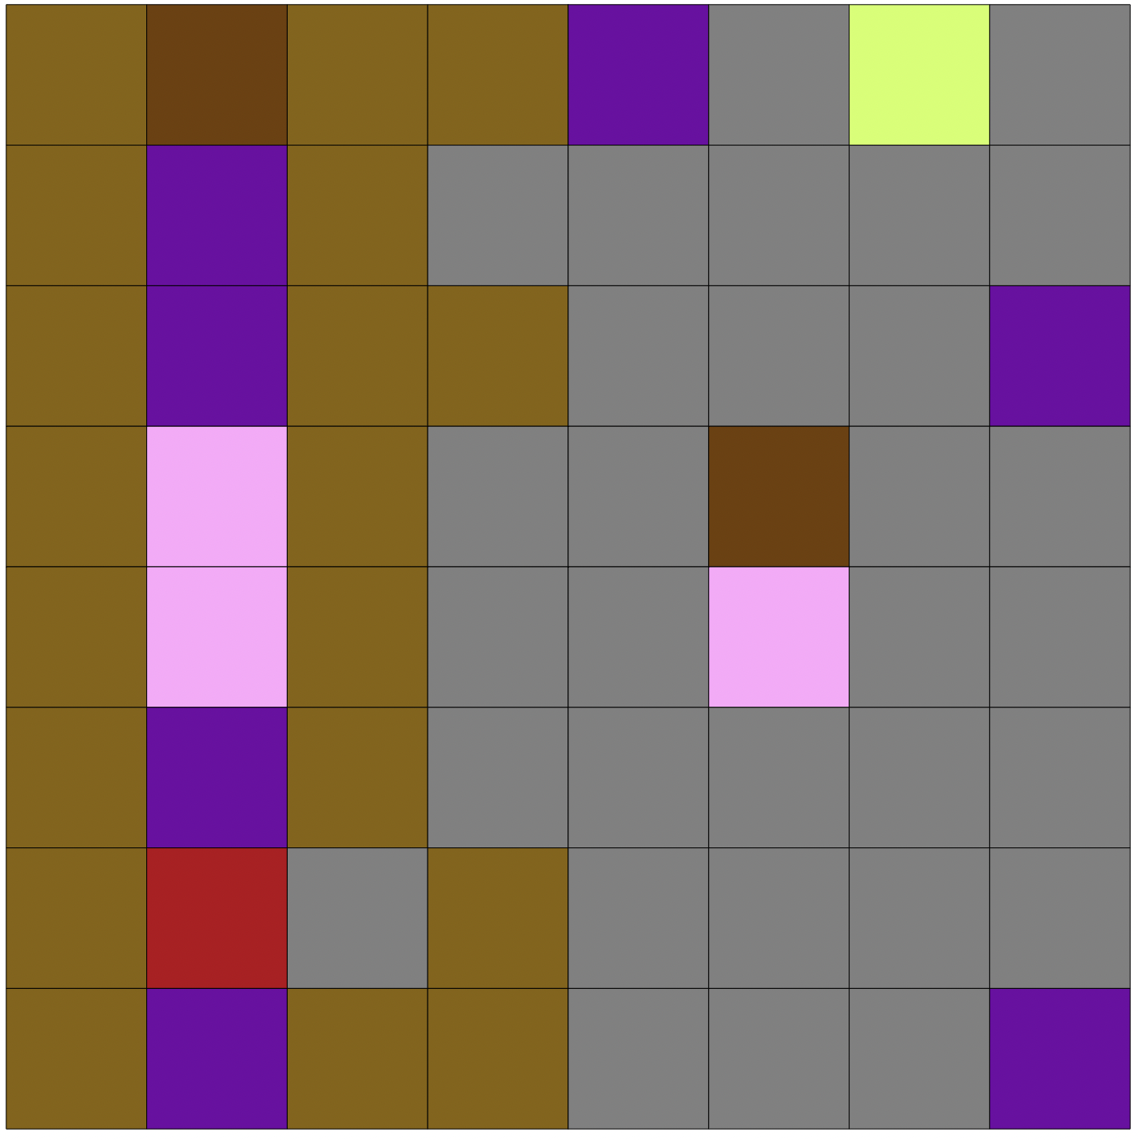
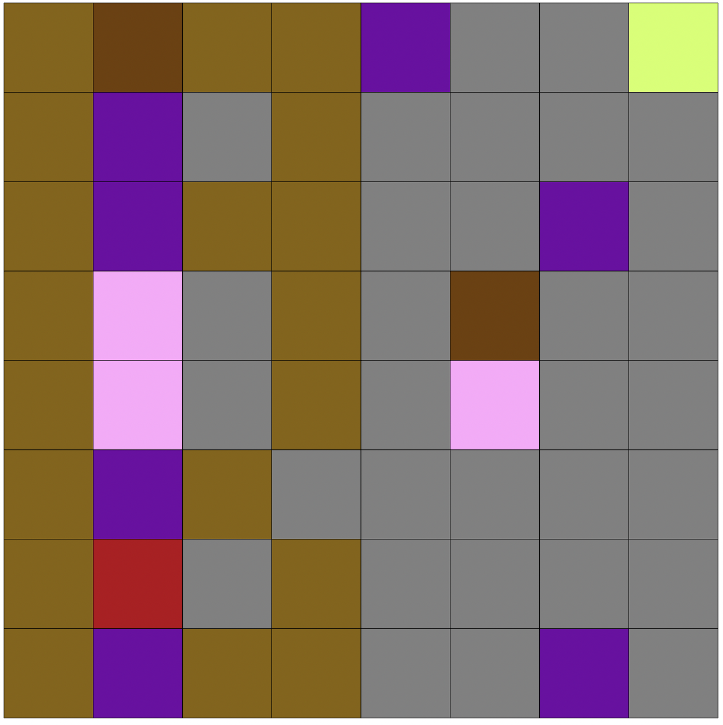
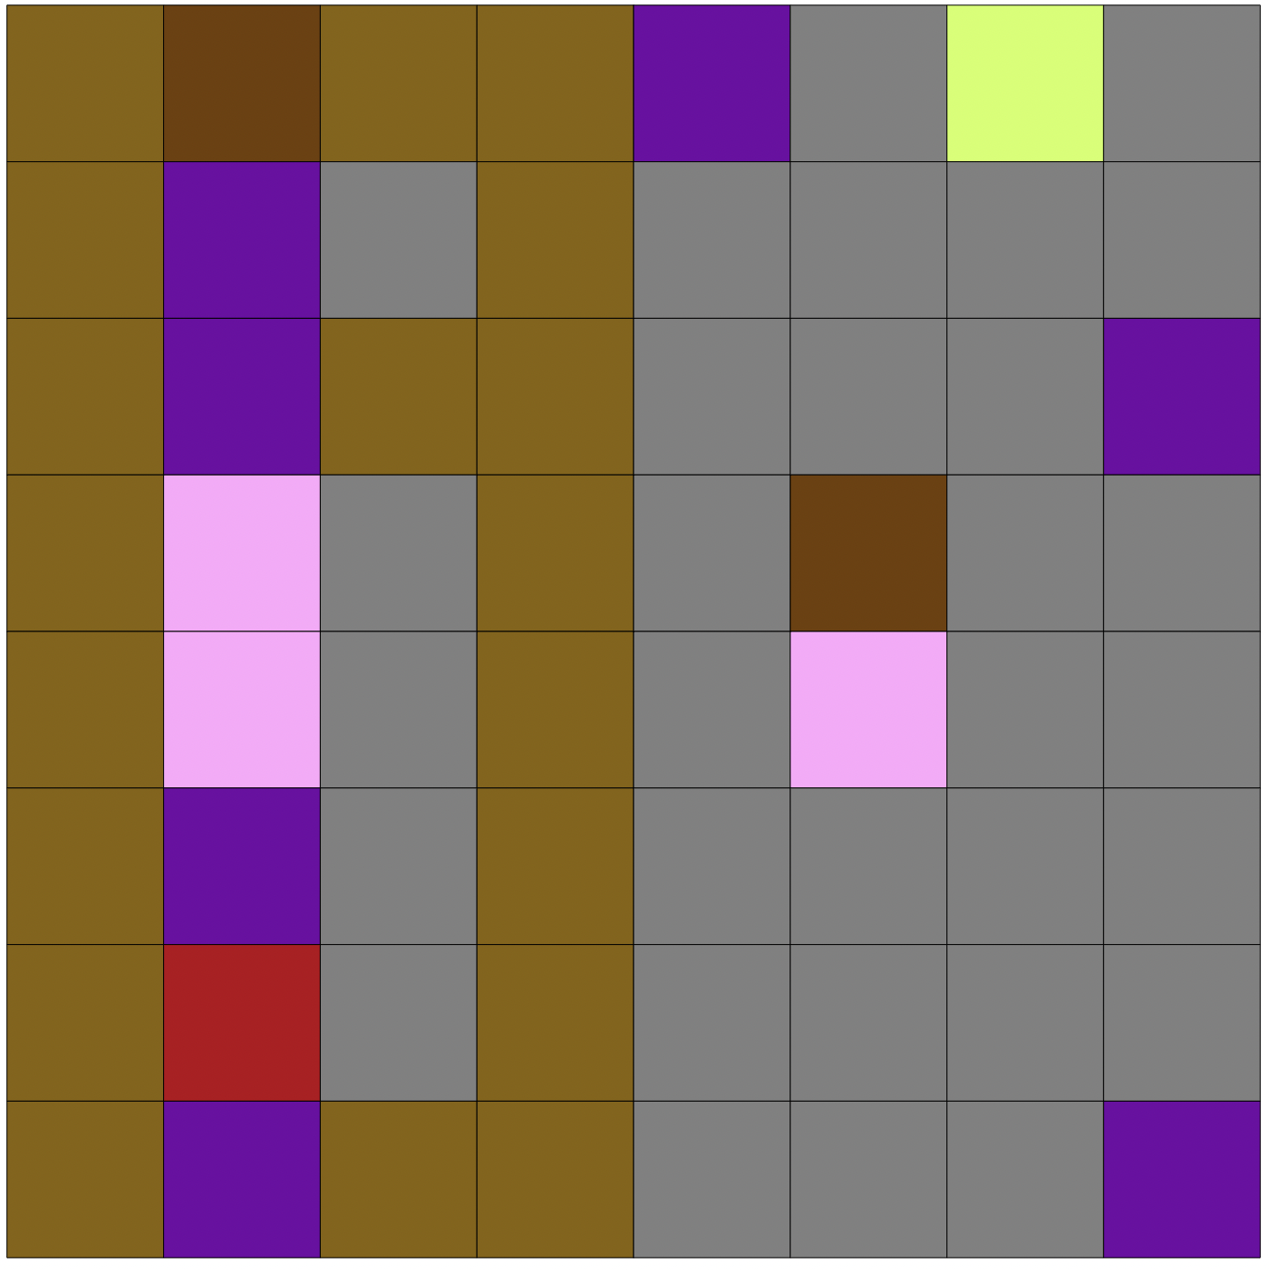
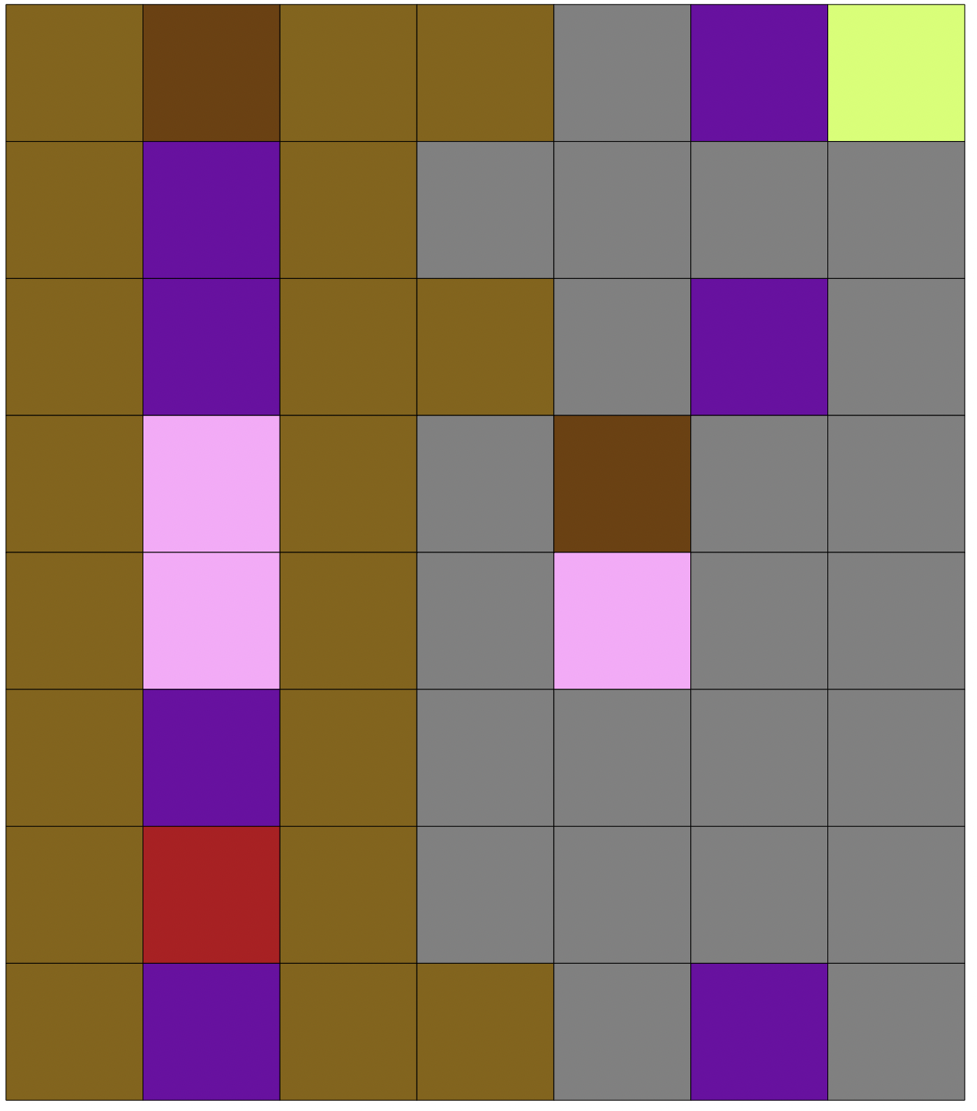
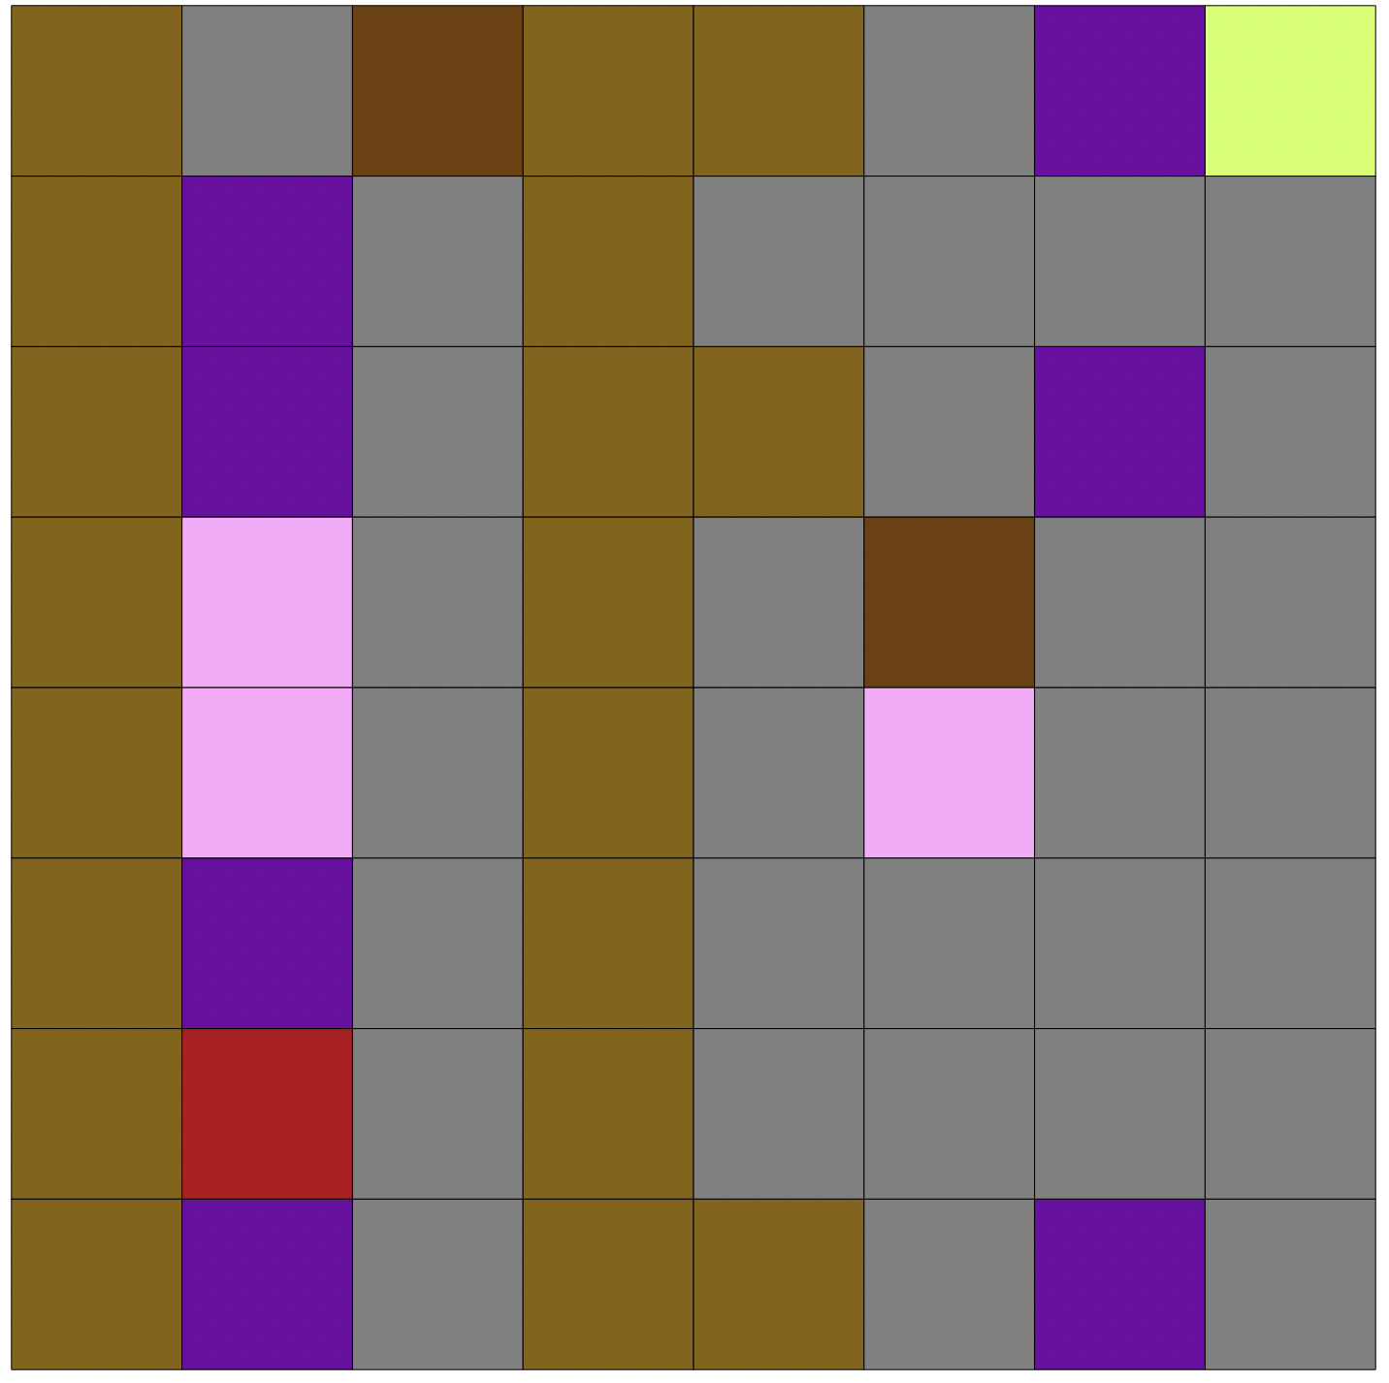
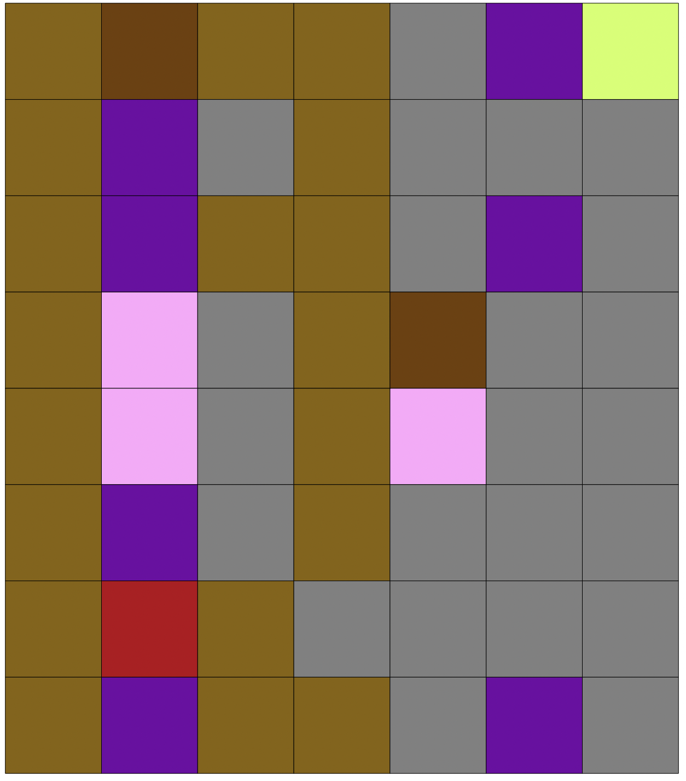
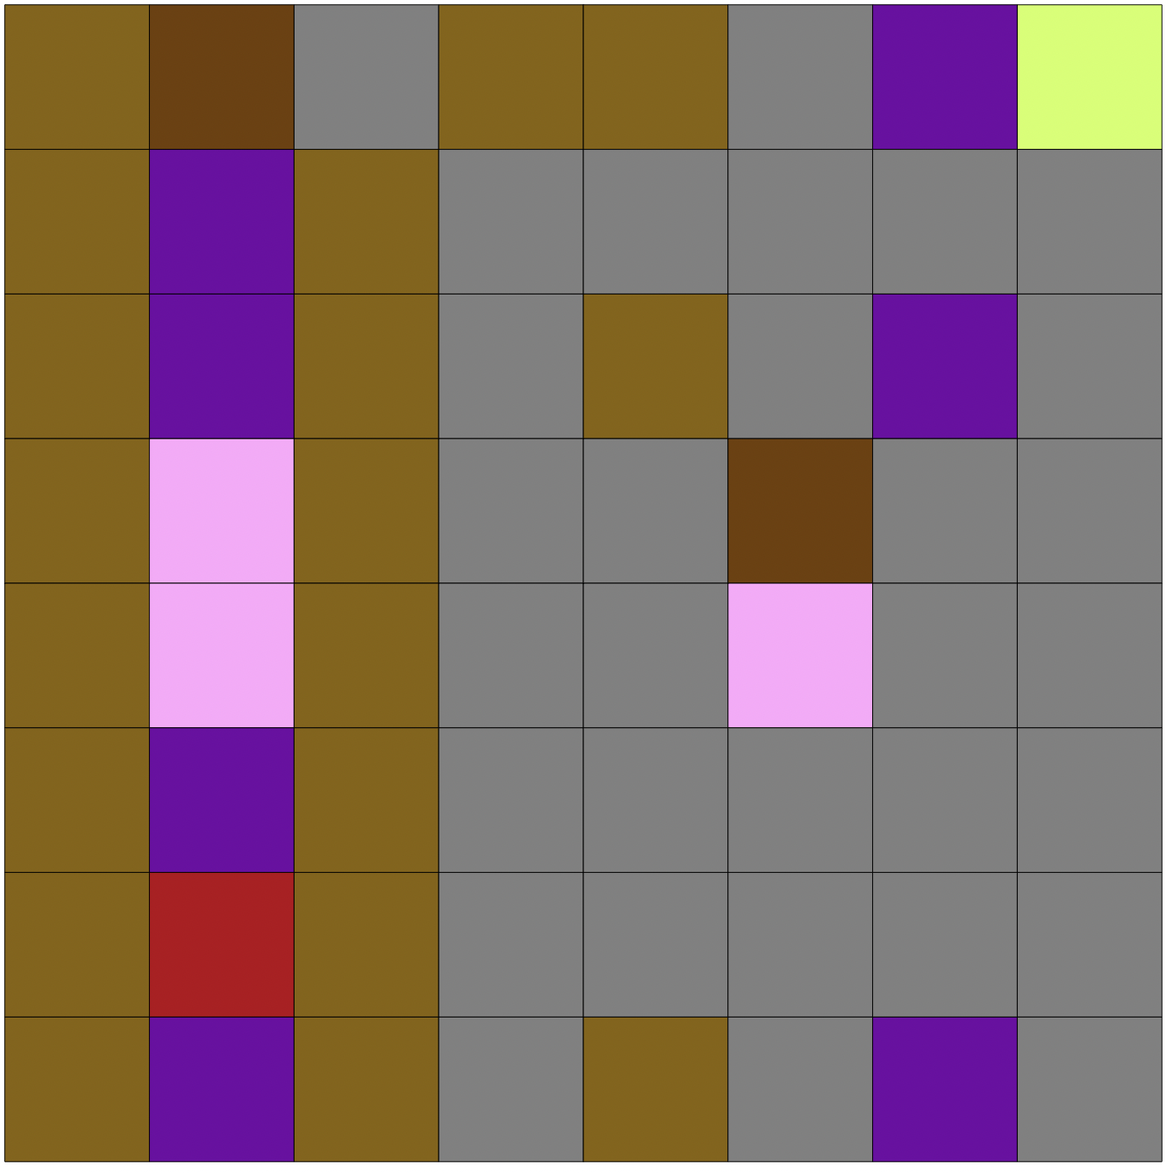
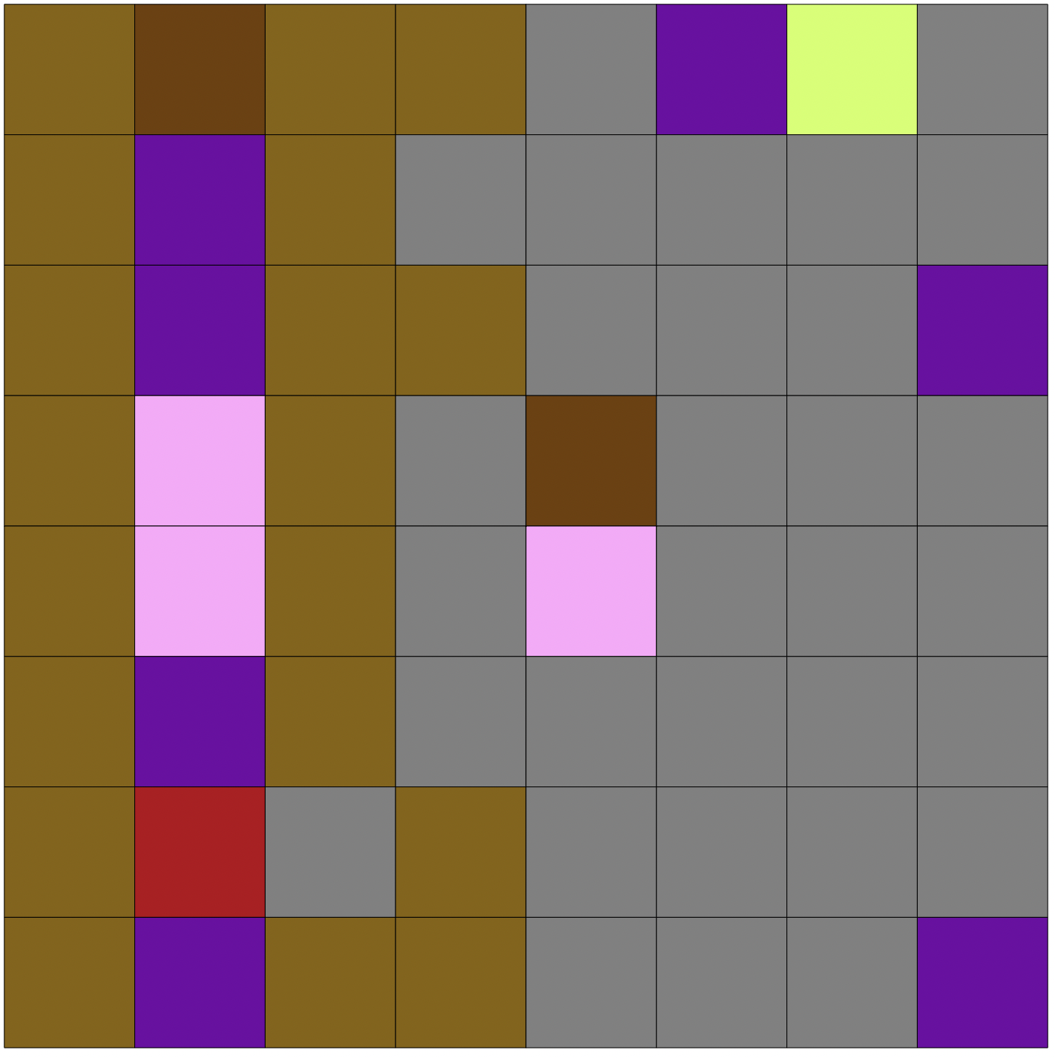
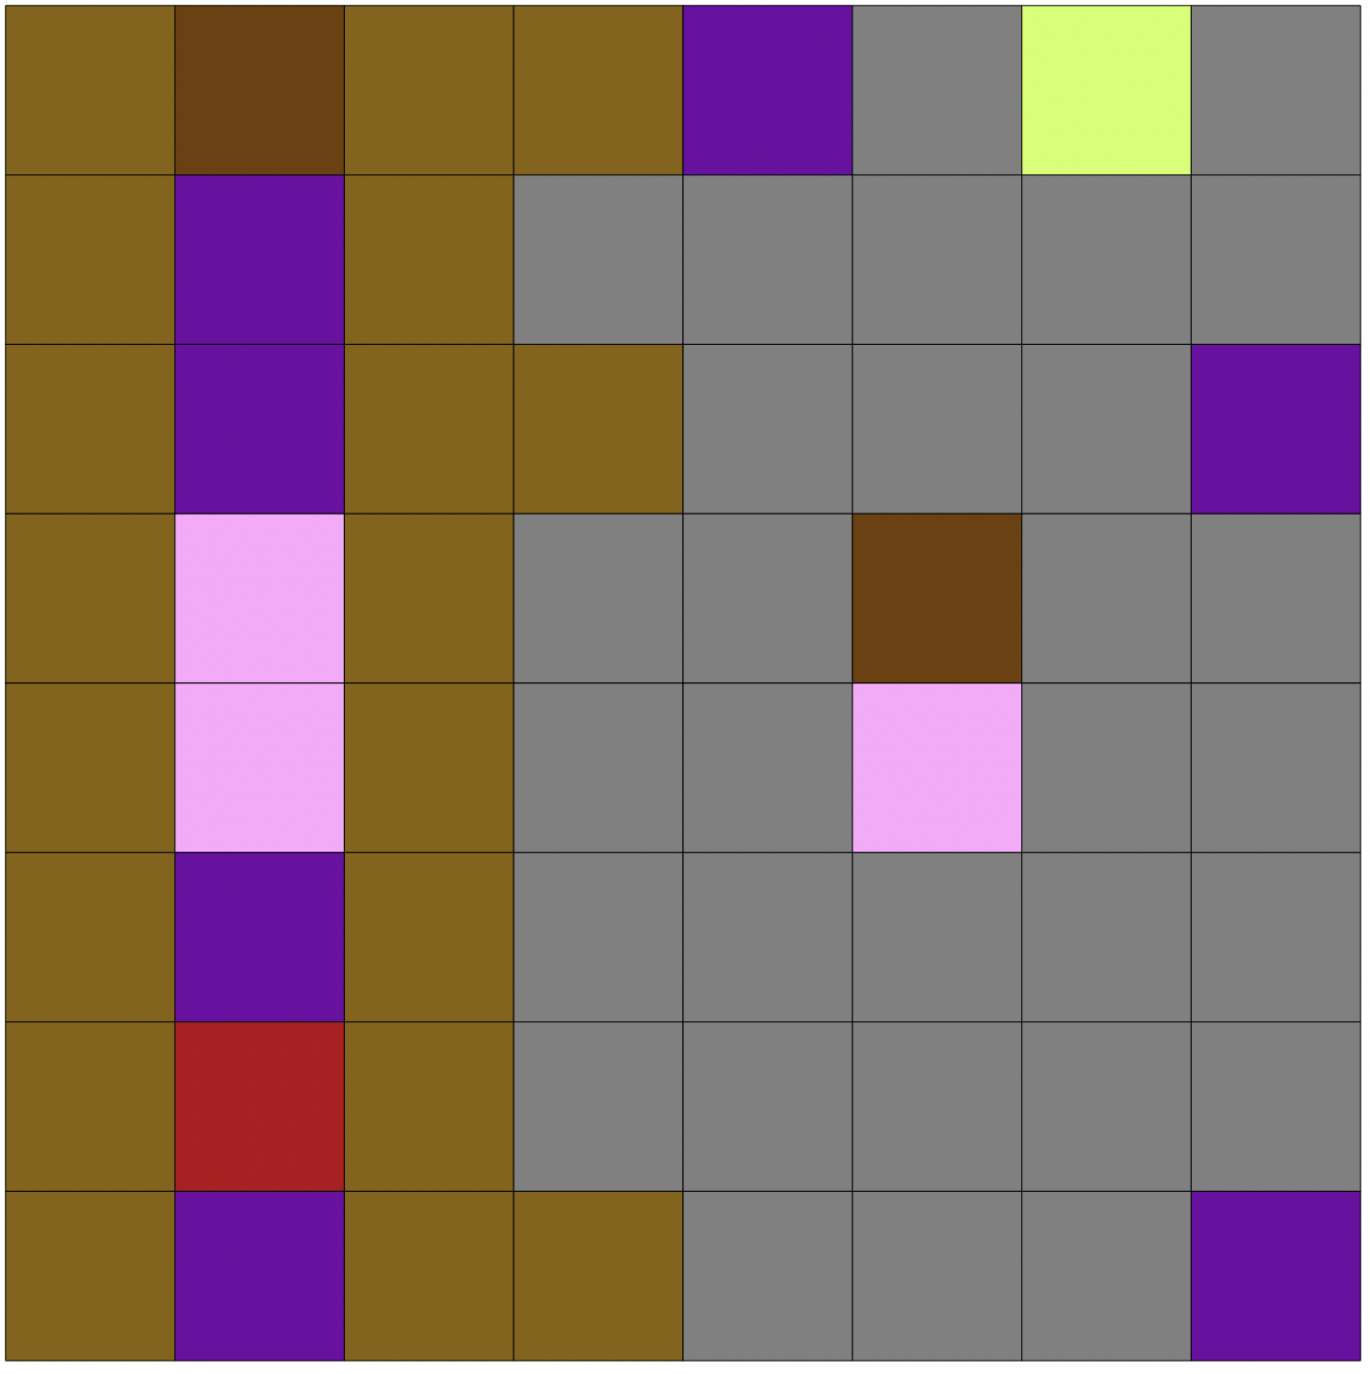













Cognate: Fish
Credible Set Size: 25 Alignments

Slide 50
Interactive Alignment Exploration

Slide 51


Slide 52


Slide 53













Cognate: Bad
Partitioned Model
Poisson Model

Slide 54

Cognate: Bad
Partitioned Model
Poisson Model

Slide 55
Why this is neat
The procedure we use is more faithful to the observations, which are the words as they are spoken by the native speakers.
Our method does not rely on coding words into binary states.
The model is event based. Words can transform via a substitution, insertion, or deletion (of single word segments).
Within the constraints of the model, then, we can learn about the evolution of language at a fine-scale level.
This method may be better suited for divergence time estimation.
Most importantly, we provide a framework for studying language evolution that goes well beyond simply estimating the relationships of languages, but allows linguists to develop and compare new (and presumably more sensible) models of language change.

Slide 56
Going Forward
Data will be frozen at the end of February
Analyses under Poisson, partitioned, and GTR models
Need to implement marginal likelihood calculations
Would like to develop the stochastic mapping machinery for examining histories of insertion and deletion (under the TKF91 model), a la Nielsen (2002).
Implement more elaborate models of language evolution, including context dependence.

Slide 57
Going Forward
Data will be frozen at the end of February
Analyses under Poisson, partitioned, and GTR models
Need to implement marginal likelihood calculations
Would like to develop the stochastic mapping machinery for examining histories of insertion and deletion (under the TKF91 model), a la Nielsen (2002).
Implement more elaborate models of language evolution, including context dependence.

Slide 58
Going Forward
Data will be frozen at the end of February
Analyses under Poisson, partitioned, and GTR models
Need to implement marginal likelihood calculations
Would like to develop the stochastic mapping machinery for examining histories of insertion and deletion (under the TKF91 model), a la Nielsen (2002).
Implement more elaborate models of language evolution, including context dependence.

Slide 59


Likelihood Ratio
Bayes Factor

Slide 60
Likelihood Ratio
Bayes Factor

Slide 61
Going Forward
Data will be frozen at the end of February
Analyses under Poisson, partitioned, and GTR models
Need to implement marginal likelihood calculations
Would like to develop the stochastic mapping machinery for examining histories of insertion and deletion (under the TKF91 model), a la Nielsen (2002).
Implement more elaborate models of language evolution, including context dependence.

Slide 62
Going Forward
Data will be frozen at the end of February
Analyses under Poisson, partitioned, and GTR models
Need to implement marginal likelihood calculations
Would like to develop the stochastic mapping machinery for examining histories of insertion and deletion (under the TKF91 model), a la Nielsen (2002).
Implement more elaborate models of language evolution, including context dependence and indels of arbitrary length

Slide 63
Bovine ATG---TTCATTAACC
Carp GTGGCA---ATCACGC
Chicken GTGACCTTCATCAACC
Human ATG---TTCGCCGACC
Loach GTGGCA---ATCACGC
Mouse ATG---TTCATTAATC
Rat ATG---TTCGTAAACC
Seal ATG---TTCATAAATC
Whale ATG---TTCATAAACC
Xenopus ATGGCA---ATTACTC
. . .
. . .
. . .
. . .
. . .
. . .
. . .
. . .
. . .
. . .

